Slide 1
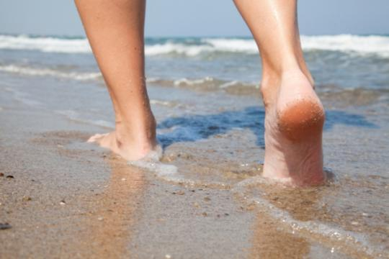
Refreshing the WINESKINS
Today’s Challenges in Consecrated Life

Slide 2
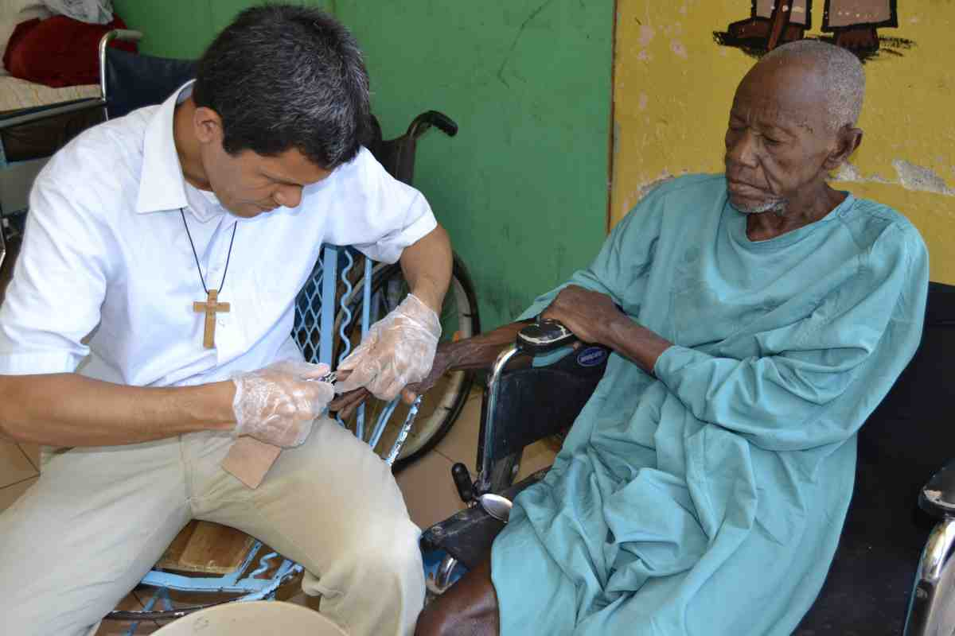
Passion for Christ, Passion for Humanity
Congress 2005
Extraordinary Missionary Month – Oct. 2019
www.october2019.va

Slide 3
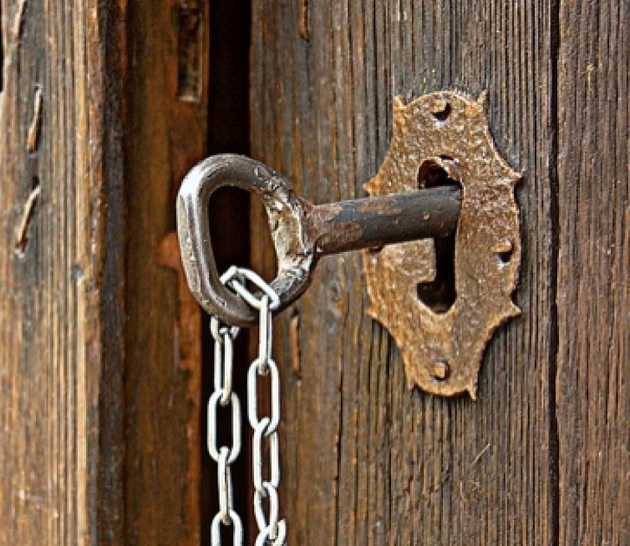
Pope Francis says
“leave your nests”;
“go out through that door
and meet the people”
“go out on the streets”;
“go to the frontiers”
“leave the centre
and travel towards the peripheries”;
“reach the fringes of humanity.”

Slide 4
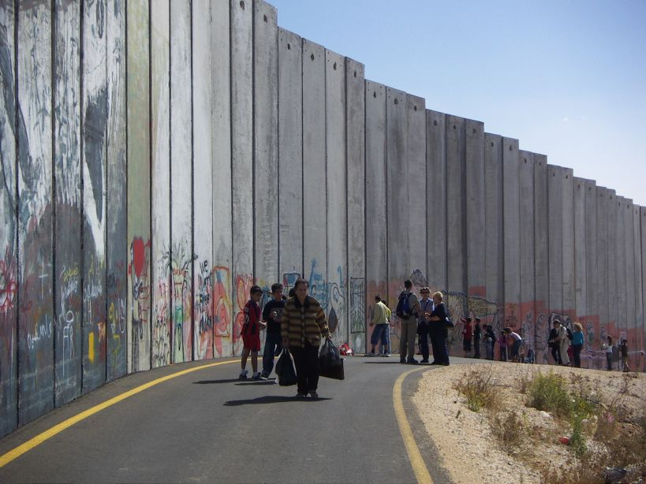
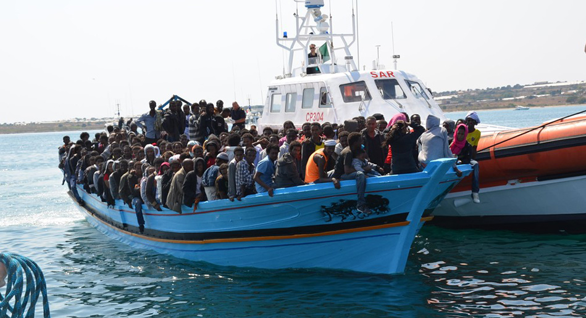
We are to be….
in this mass of humanity,
in the Caravan of People?

Slide 5
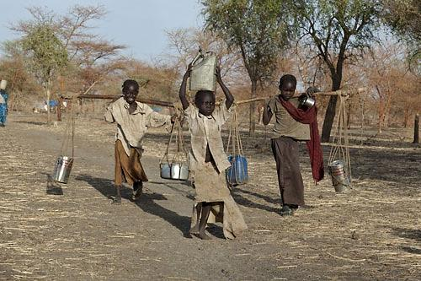
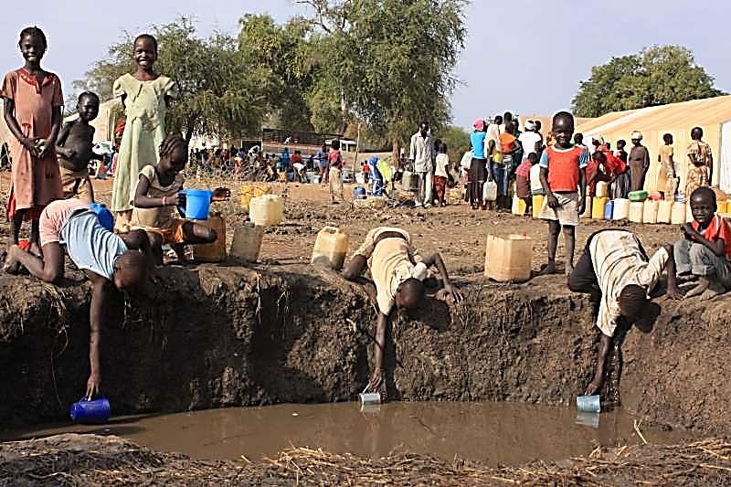
Seeking recognition
and respect
for the legitimate rights
of individuals and peoples

Slide 6
Protecting human dignity
and identity amid the flow of
digital communications
and the world of networks

Slide 7
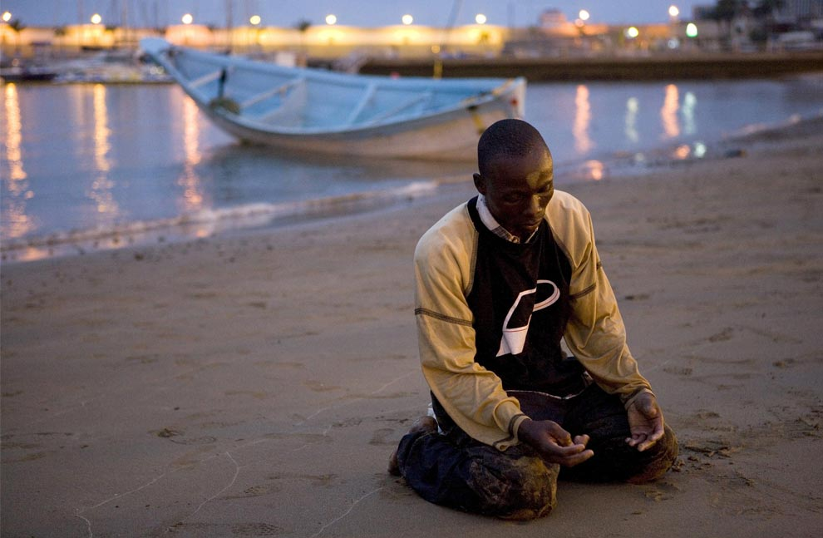
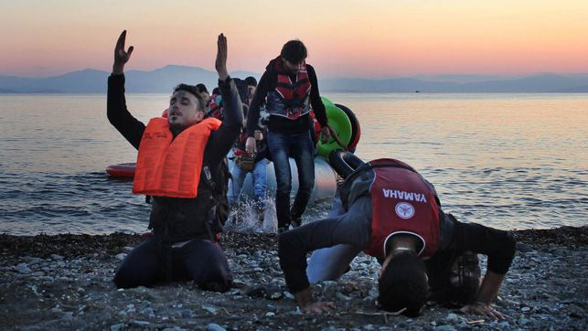
Listening to
and respond to
the spiritual yearnings and desires
of the people of our times

Slide 8
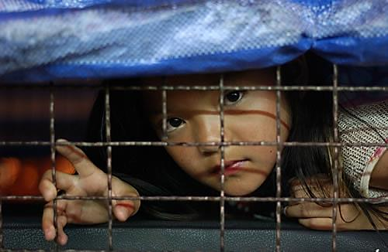
Being present with the weak and defenceless, especially those at the mercy
of economic interests
or indiscriminate exploitation

Slide 9
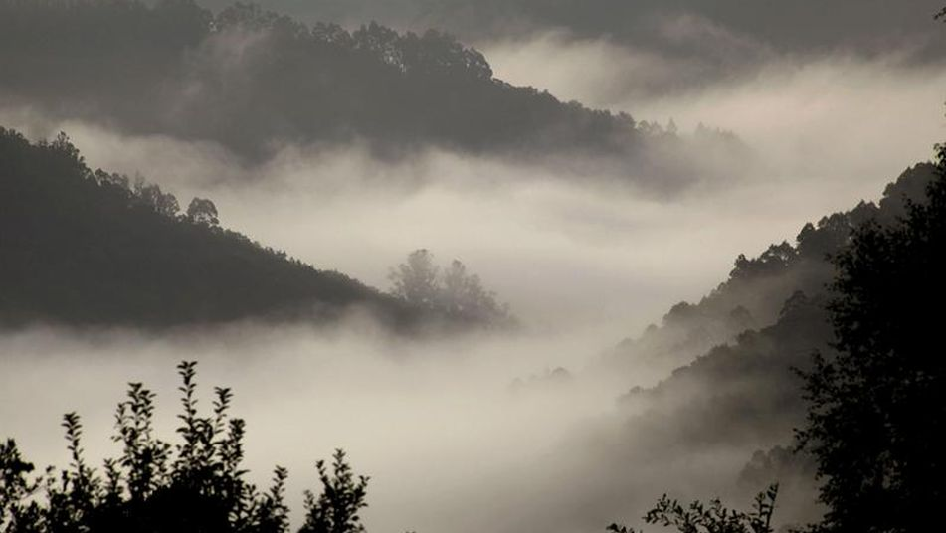
Protecting our common home –
the earth
which has been burdened
and laid waste

Slide 10
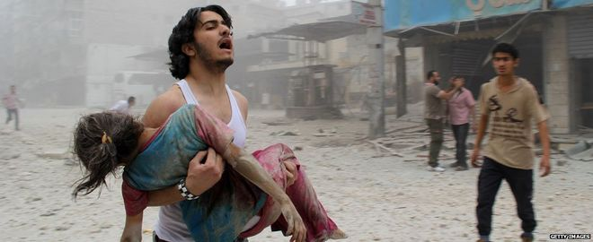
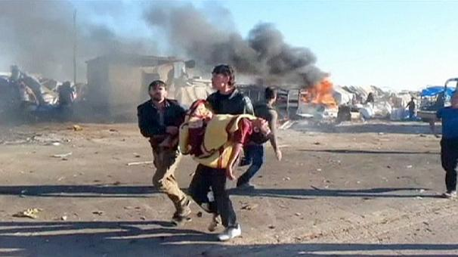
Going among people threatened by war and violence

Slide 11
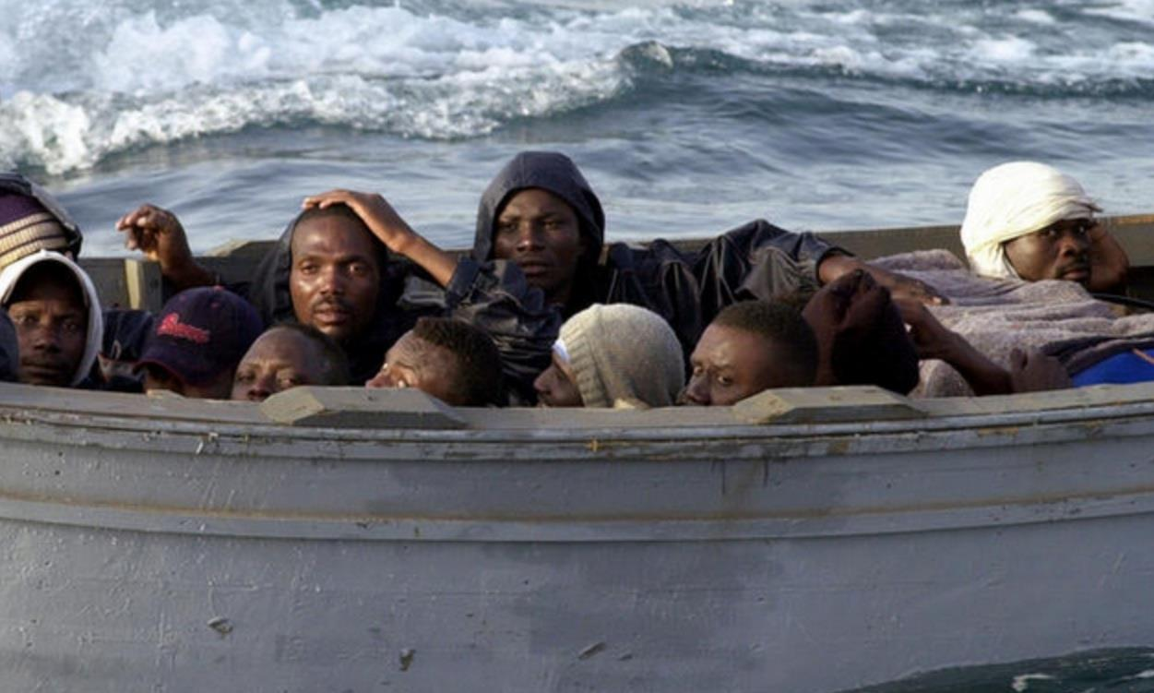
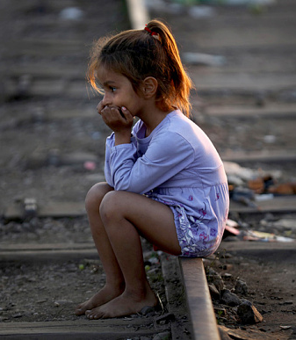
Being with migrants .

Slide 12
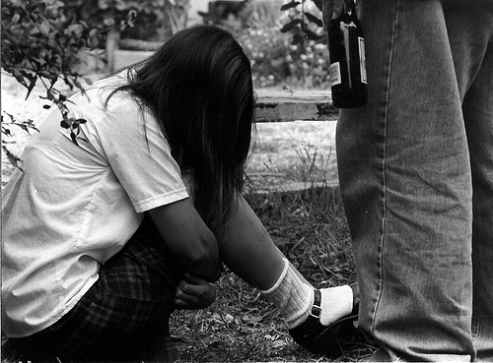
With
victims of human trafficking
and new forms of slavery,
women who have suffered exclusion,
mistreatment and violence

Slide 13
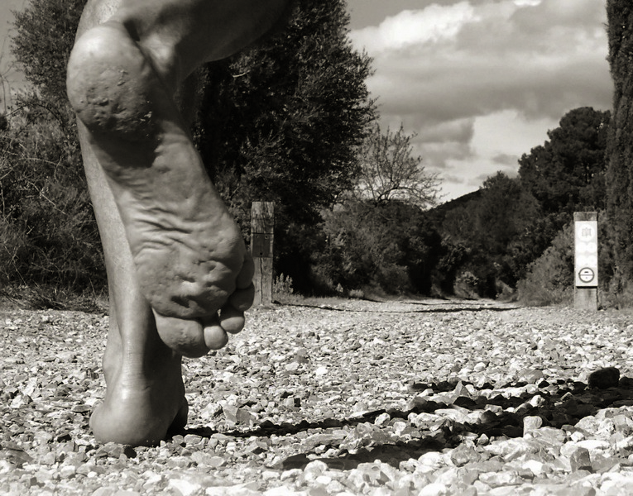
“finding new and
courageous ways to reach all” and
“to go beyond, not just beyond,
but beyond and into
the thick of things,
where everything is as stake.
Pope Francis

Slide 14
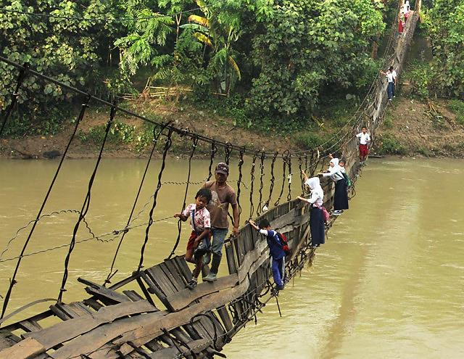
These margins calling us onward are “geographic, urban and existential” “they are margins of the mystery of sin,
pain,
injustice
and misery.”

Slide 15
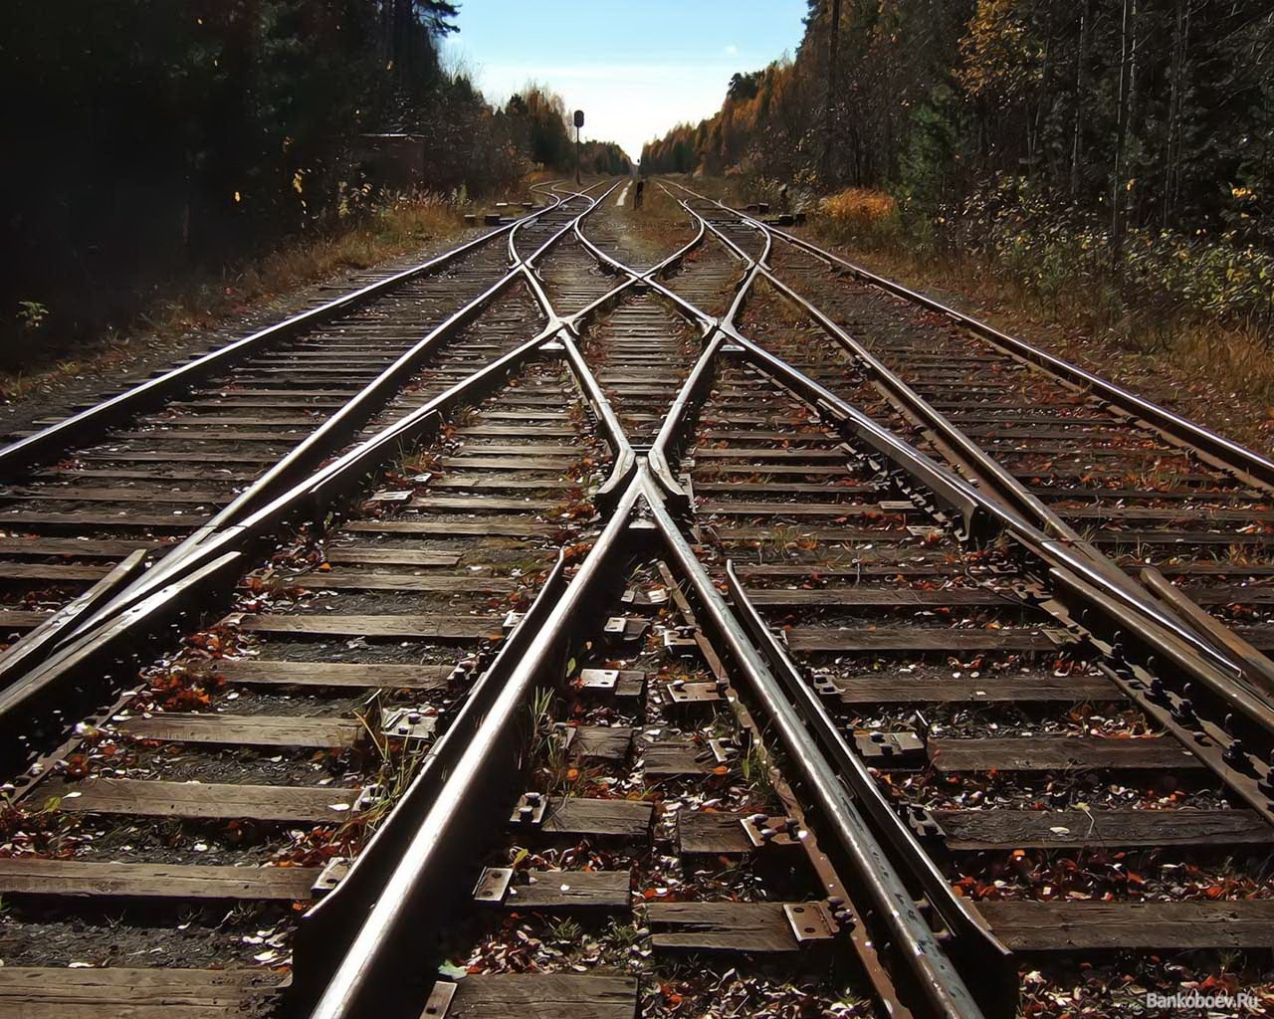
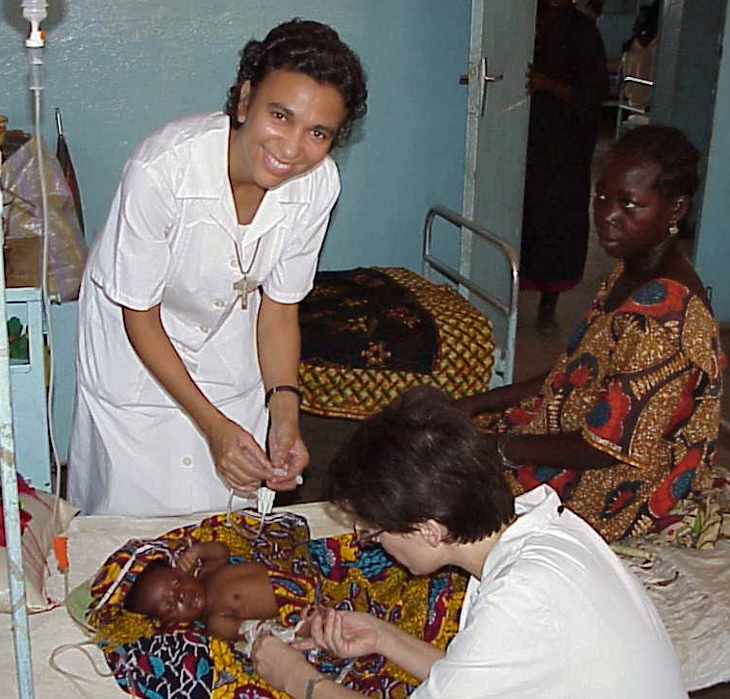
To begin anew

Slide 16
“And no one puts new wine into old wineskins; otherwise the new wine will burst the skins and it will be spilled out, and the skins will be ruined. But new wine must be put into new wineskins. And no one, after drinking old wine wishes for new; for he says, ‘The old is good enough.’” Luke 5 36-39
This text is also found in Mark 2:21-22 & Matthew 9:16-18

Slide 17
Wineskin made of GOAT SKIN

Slide 18
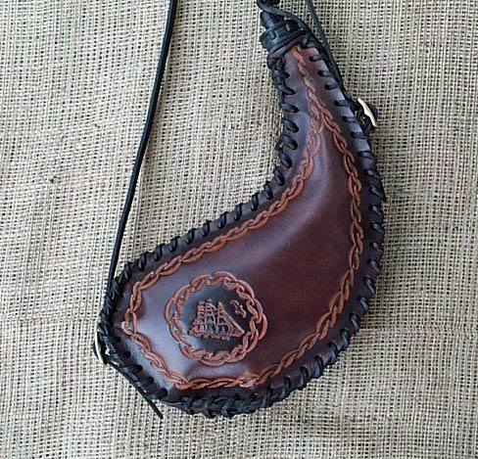
Wineskins can also
be made
of leather

Slide 19
Old Wineskin
Becomes brittle
Loses its elasticity
Expands when the wine ferments
Bursts because of the inside pressure
New wine is wasted

Slide 20
How to make an old wineskin fresh again?
It has first to be cleaned
Then soaked in oil
Finally tested to make
sure that it is supple
and soft.

Slide 21
What is being emphasized in this Scripture passage by St. Luke?
“Fresh” wineskins remind us not to remain attached to old standards and rigid forms of the past
Need for a constant supply of fresh wine
The impossibility of dialoguing with old mentalities
Called to radical newness, prophetic newness of the joyful and lively proclamation of the gospel in new ways and in new places

Slide 22
Newness demands:
Acceptance of change
Discernment
Structures and processes that safeguard the innovative richness of the Gospel so that it can be lived and put at the service of all while preserving its quality and goodness.

Slide 23
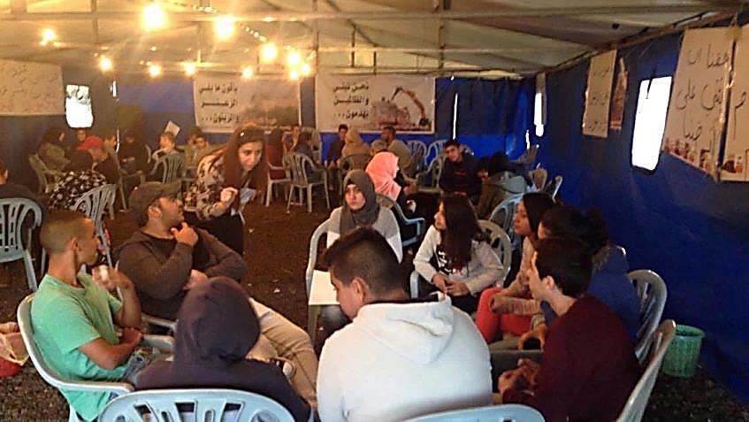
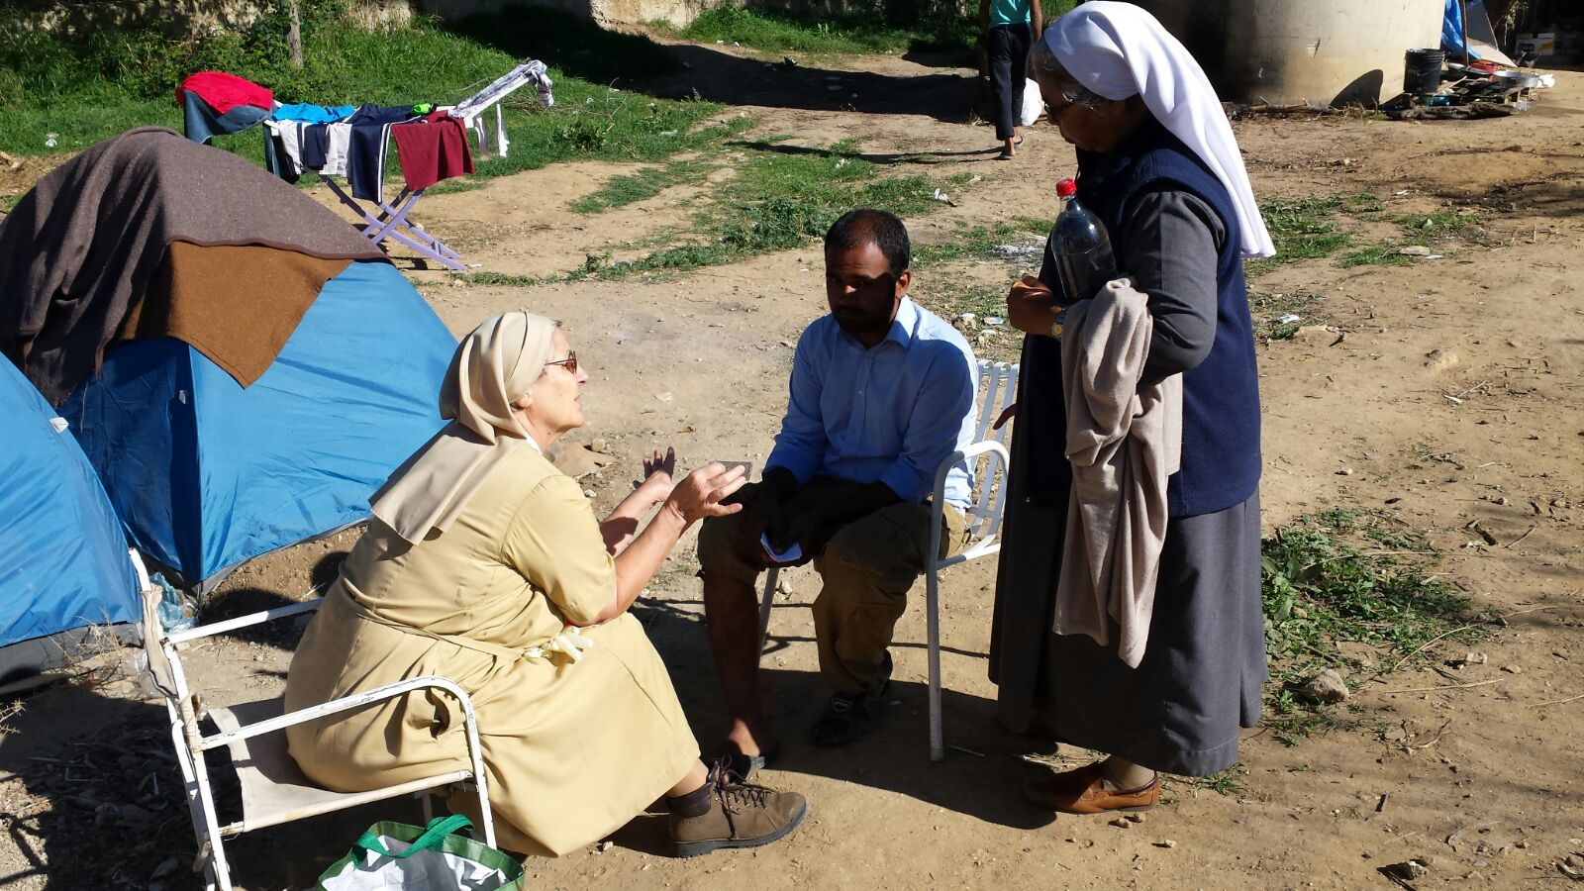
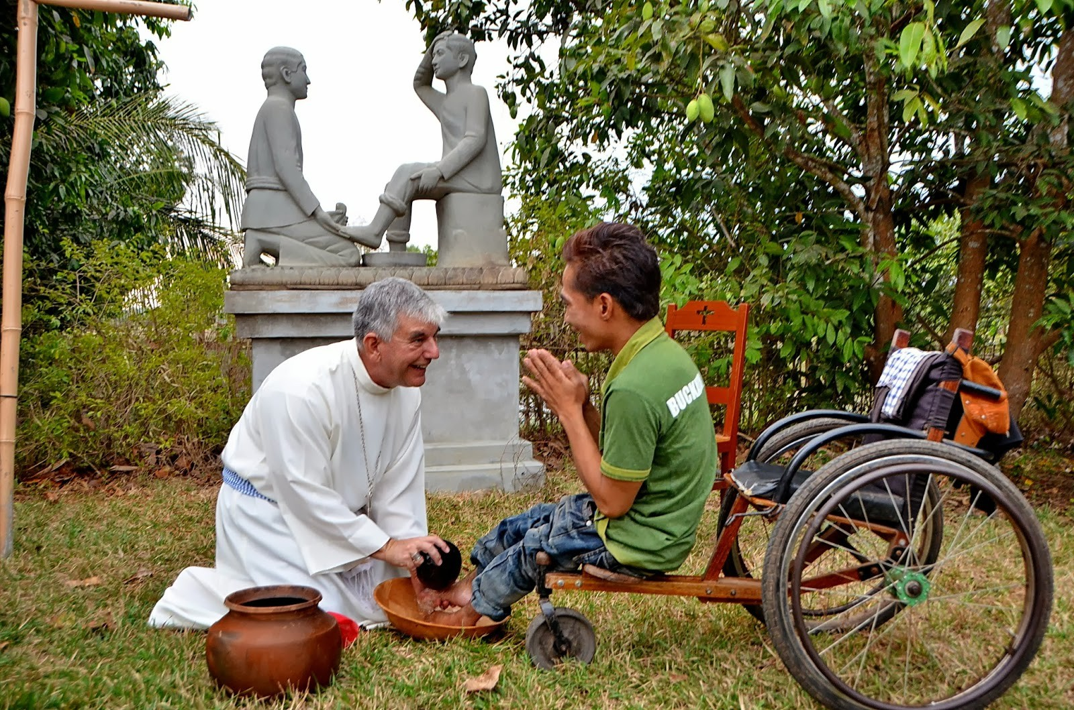
NARRATIVE OF ENCOUNTER

Slide 24
We are being called to search
the horizons of our own lives and of our times
in watchful prayer.

Slide 25
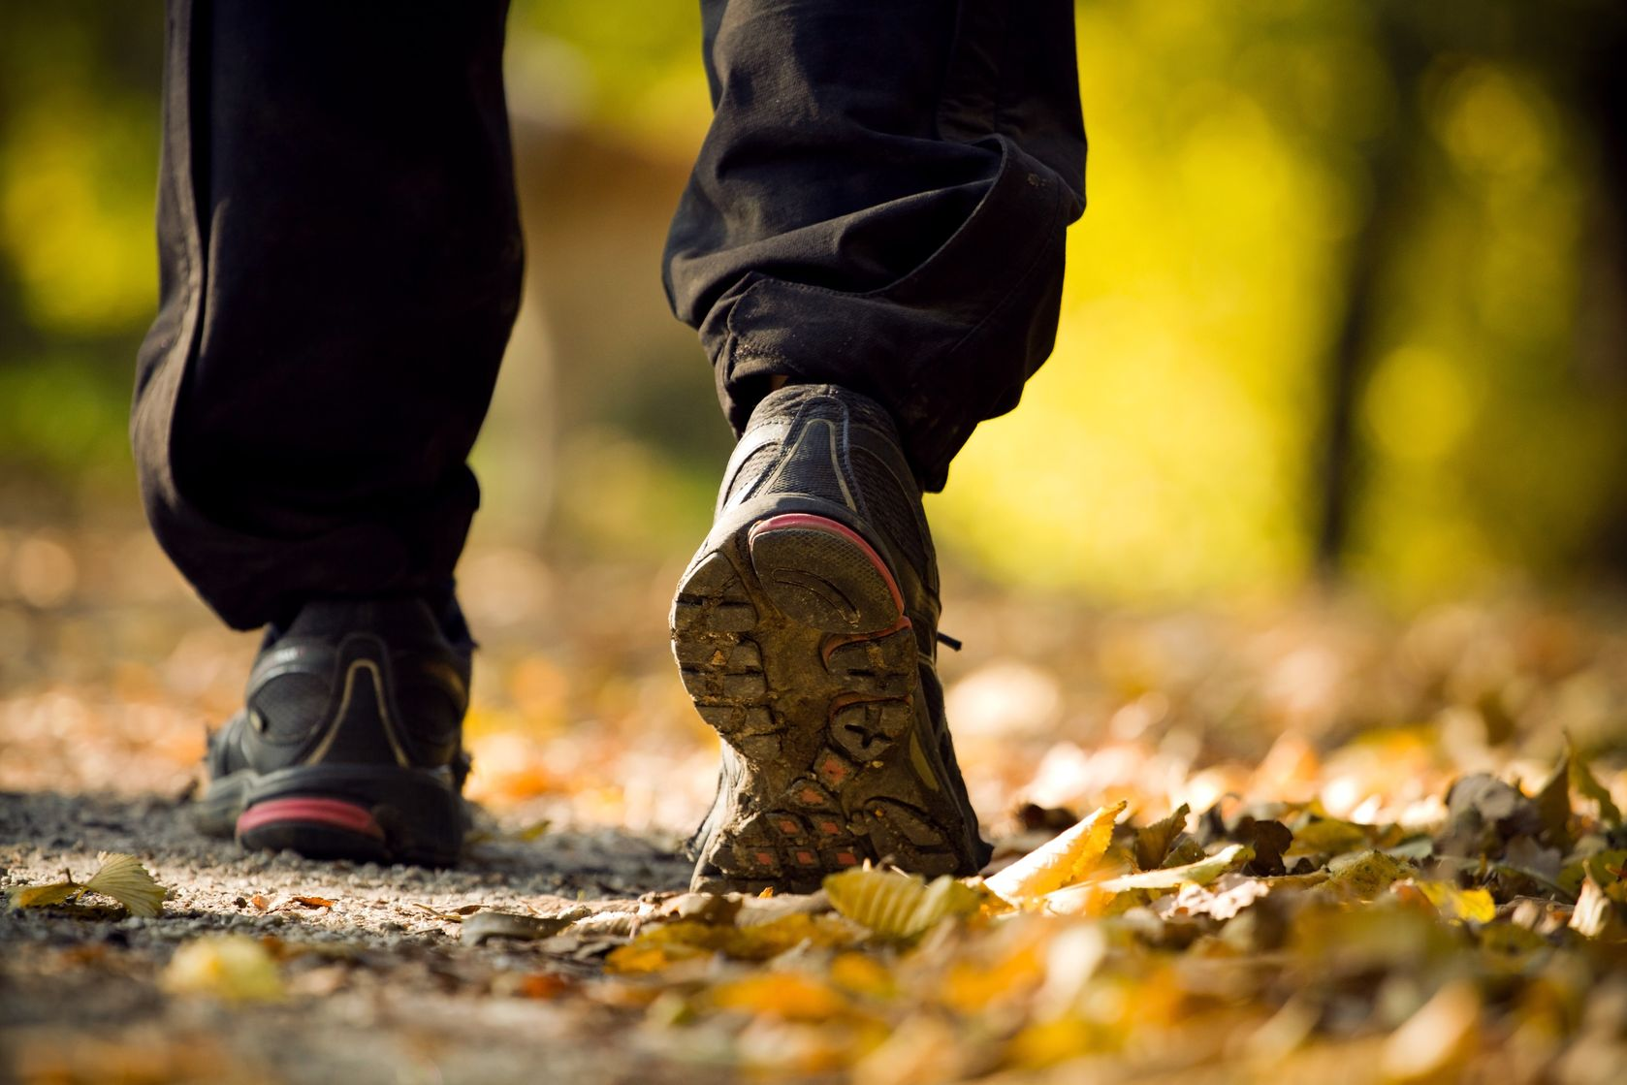
Whenever we make the effort to return to the source and to recover
the original freshness of
the Gospel new avenues and new paths of creativity open up. (EG#11)

Slide 26
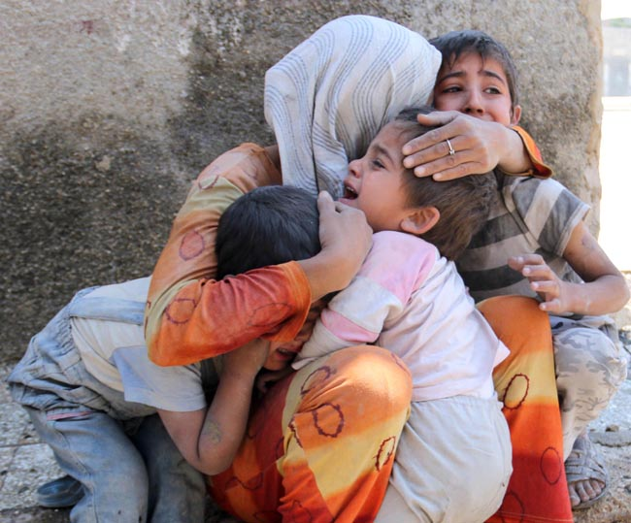
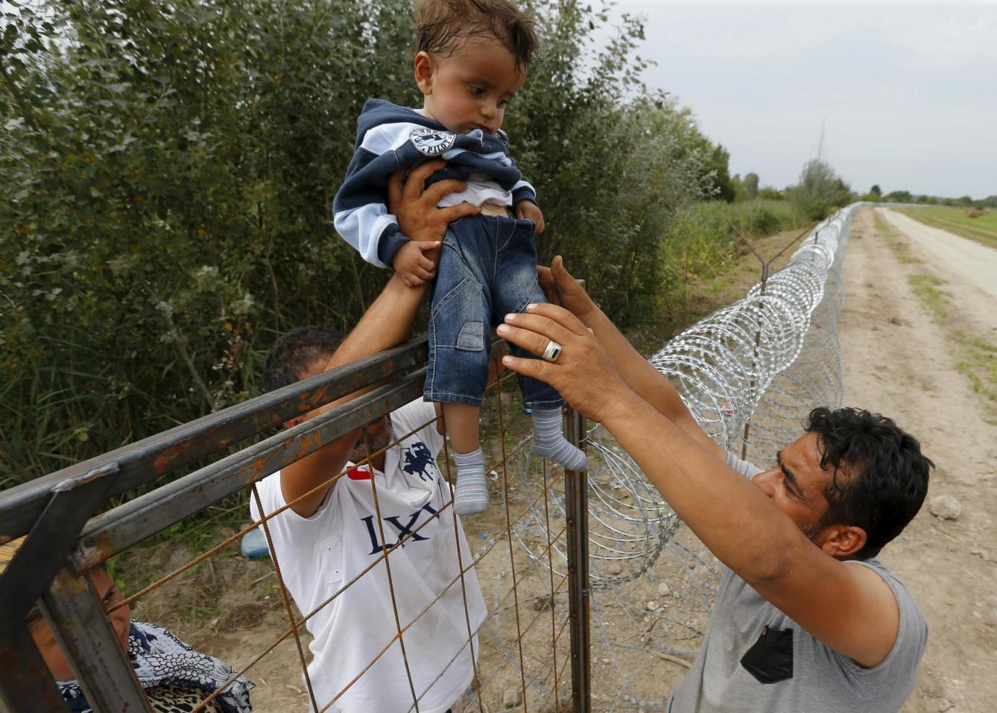
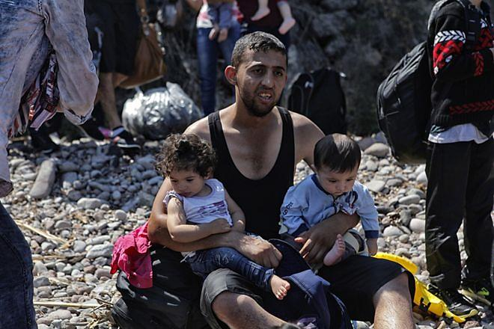
Pope Francis
“step out……..in this ‘stepping out’
it is important to be ready
for encounter.”

Slide 27
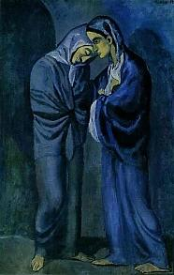
Spanish word
“encuentro”
The Visit (Two Sisters) PICASSO
1902
Las dos hermanas, Picasso

Slide 28
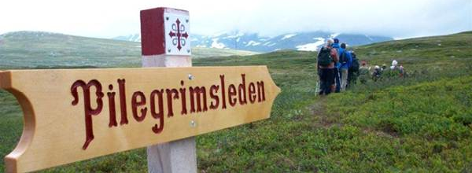
A prophetic journey of transformation,
both inward and outward

Slide 29
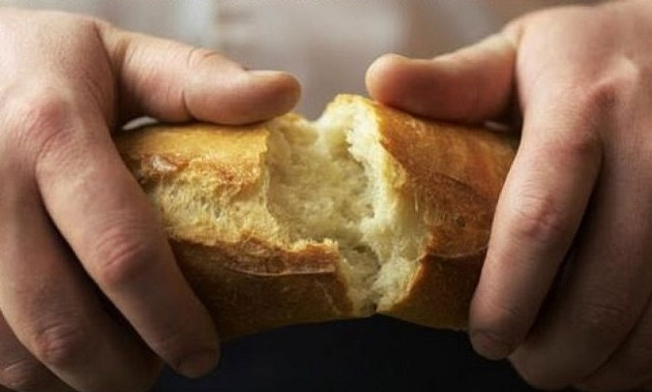
The NARRATIVE
of COMMUNION

Slide 30
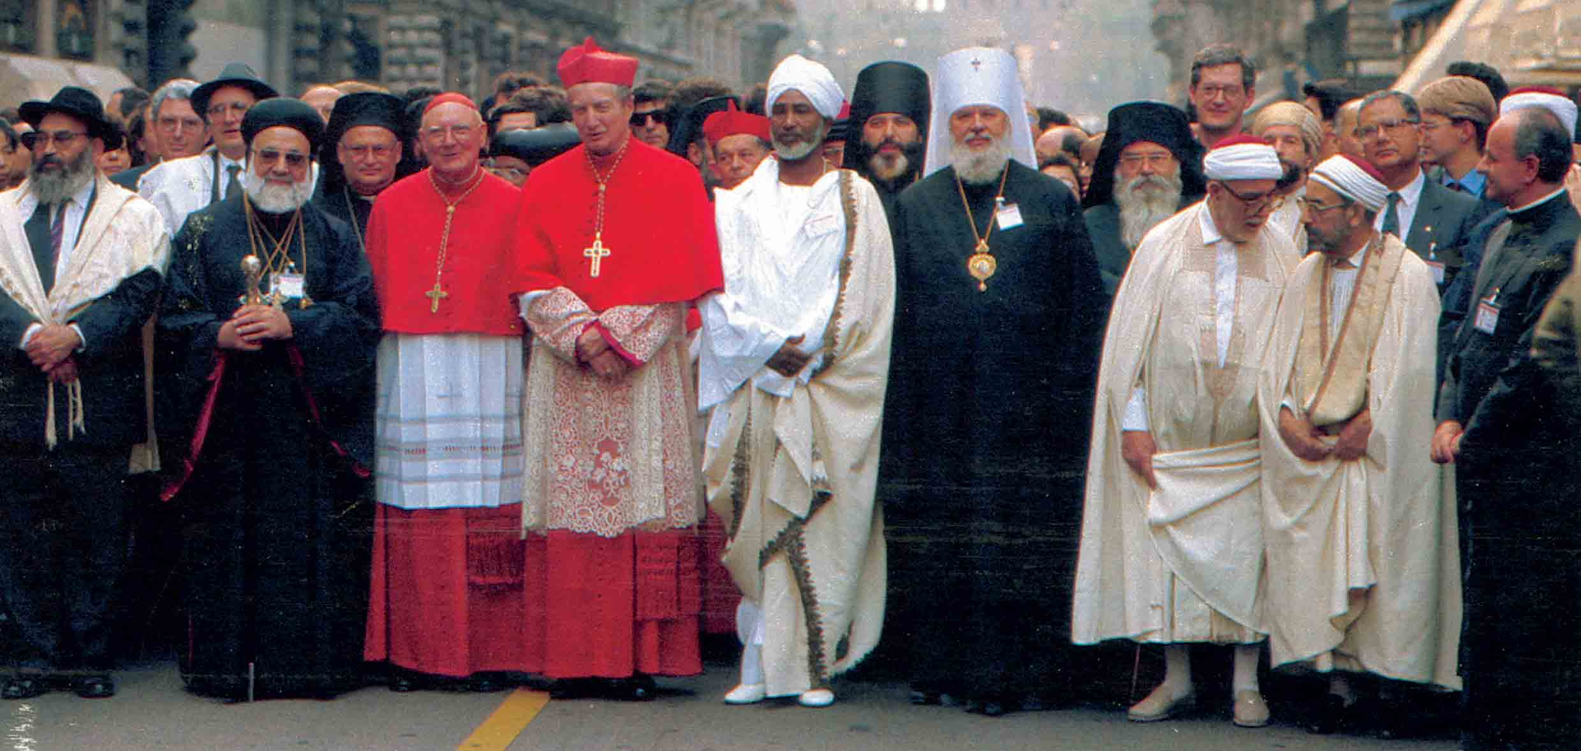
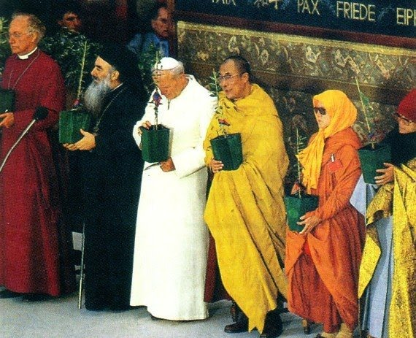
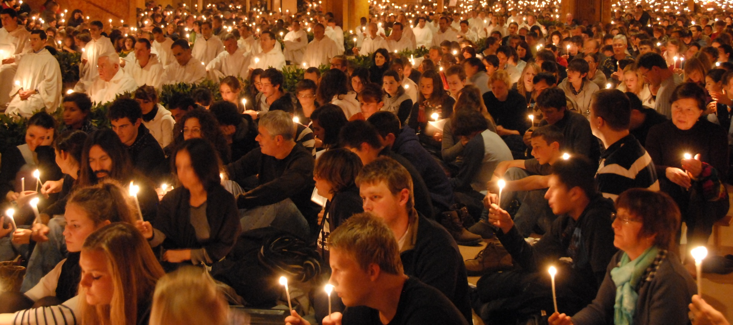
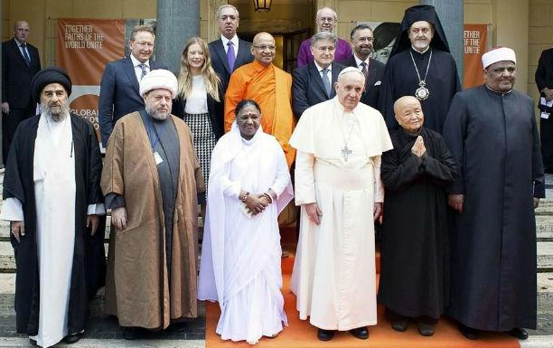
“Experts in communion”

Slide 31
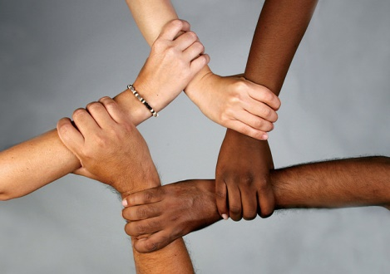
“Have passed from almost entirely
monocultural contexts to the
challenge of
living interculturally.”

Slide 32
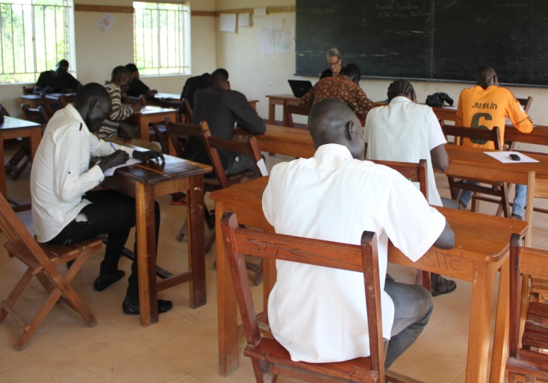
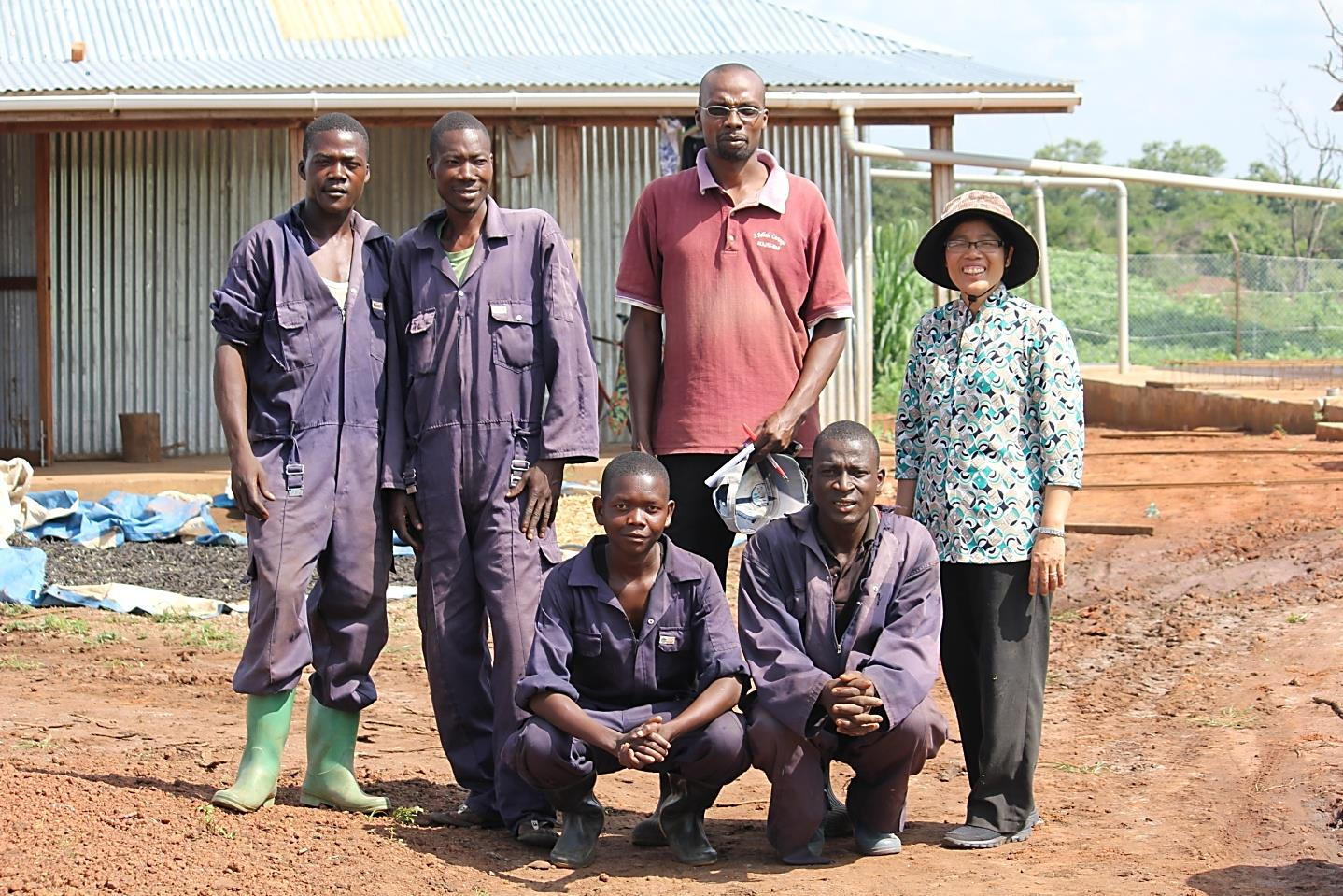
South Sudan

Slide 33
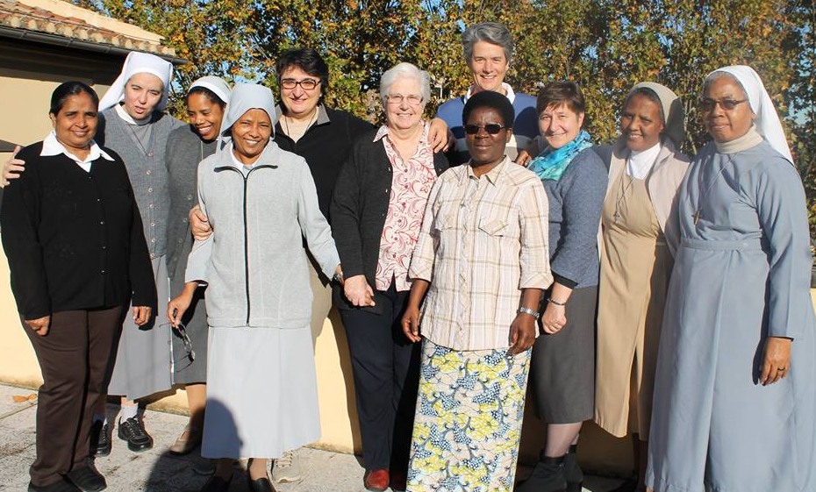
Different religious communities
and different nationalities
Notes:
CARMEN

Slide 34
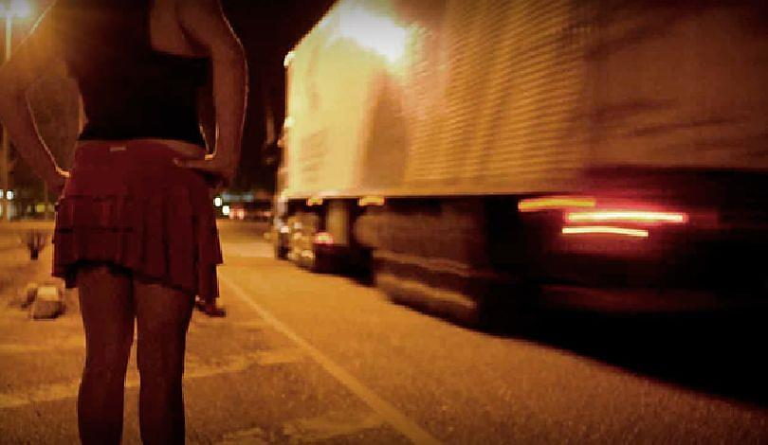
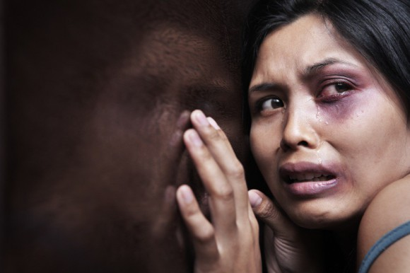
Human Trafficking

Slide 35
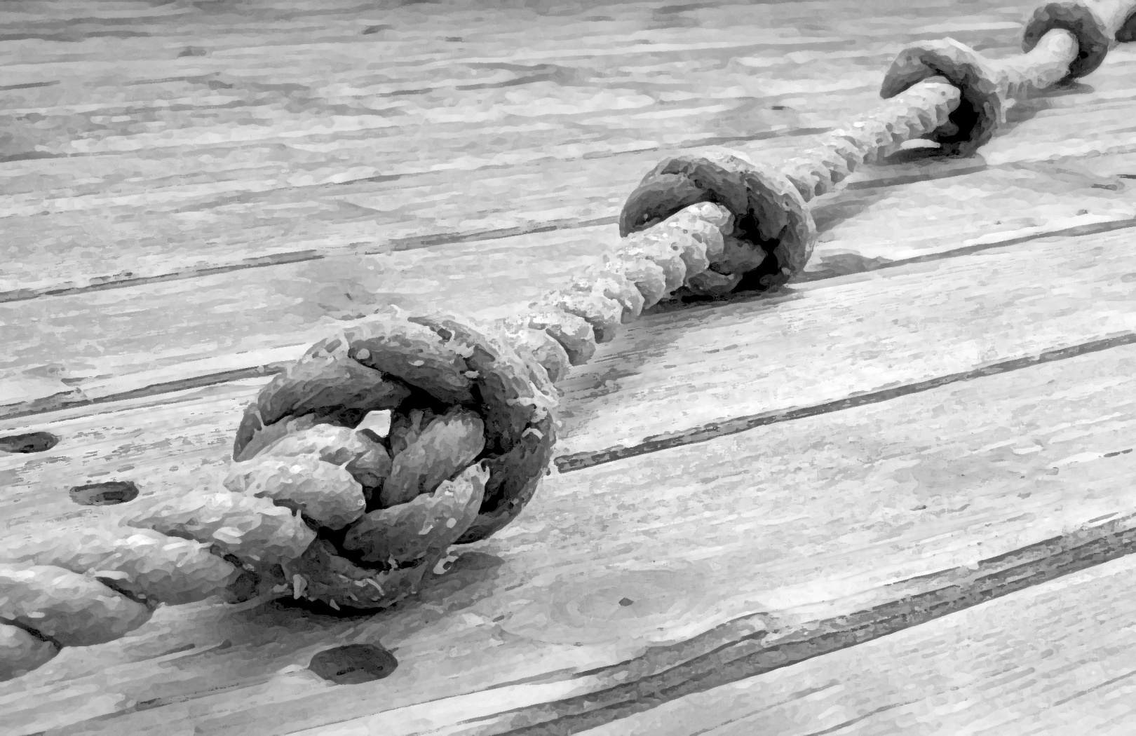
Talitha Kum
40 networks
Pope Francis
“We must be more aware
of this new evil that,
in a global world, wants to hide it”
and that all men and women of good will are called
“to renew their commitment in improving
the human condition.”

Slide 36
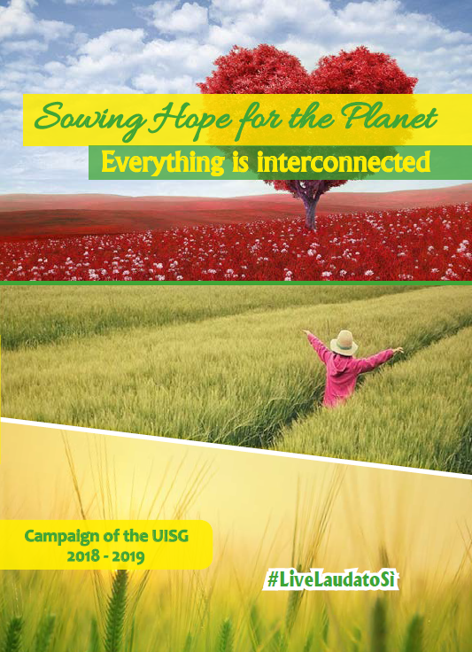
UISG Three Year Campaign Sowing Hope for the Planet 2019-2022 involving religious congregations worldwide
2019-2022

Slide 37
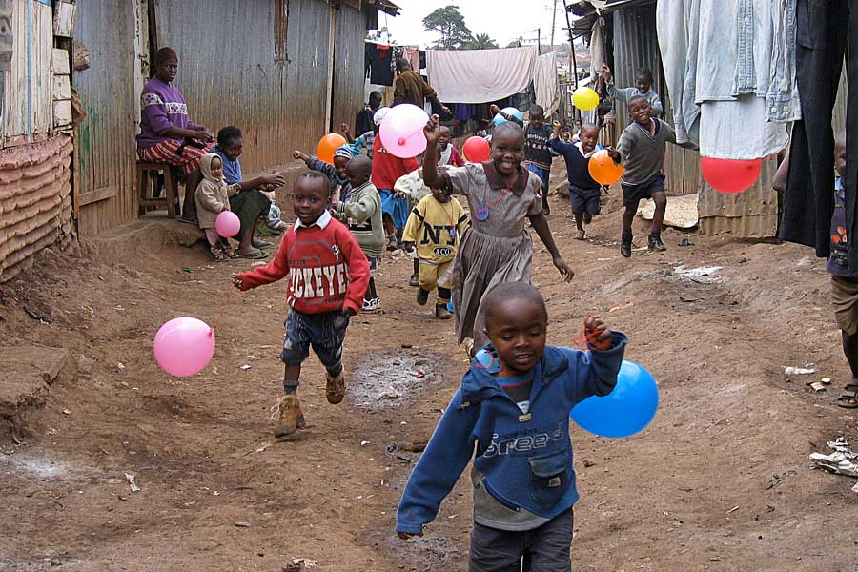
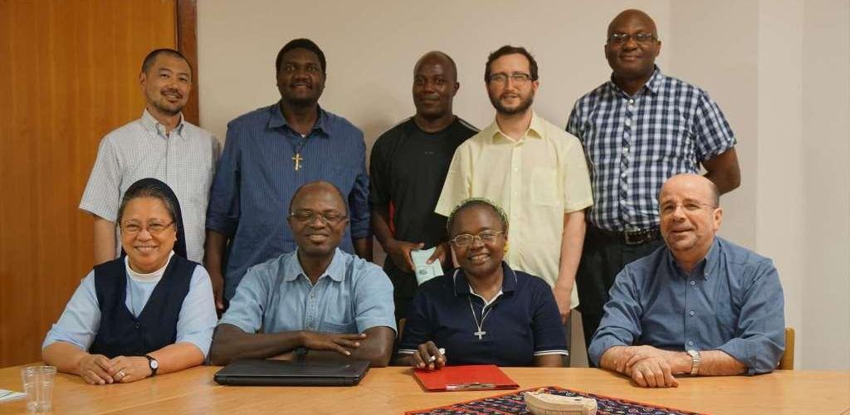
The Africa Europe
Faith and
Justice Network

Slide 38
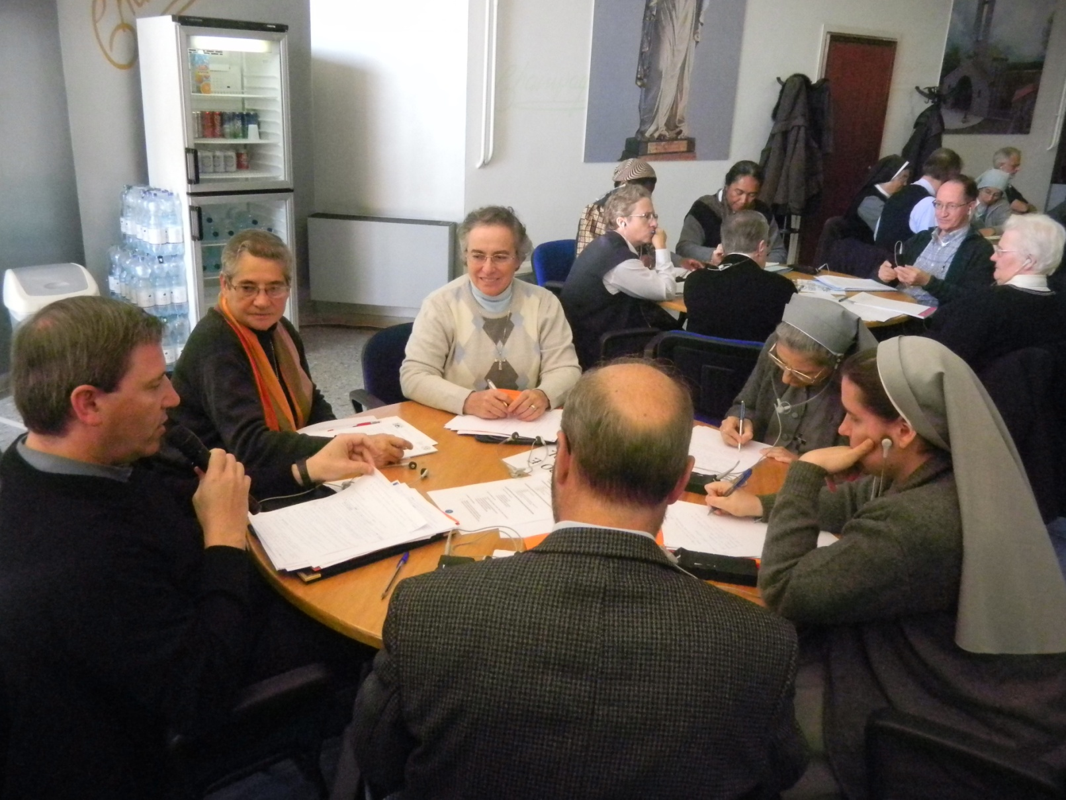
We are called to offer
a concrete model of community which,
by acknowledging the dignity of each person and sharing our respective gifts,
makes it possible to live
as brothers and sisters

Slide 39
How else are we being called to collaborate together and support one another today?
- Education? Health care? Resources?

Slide 40
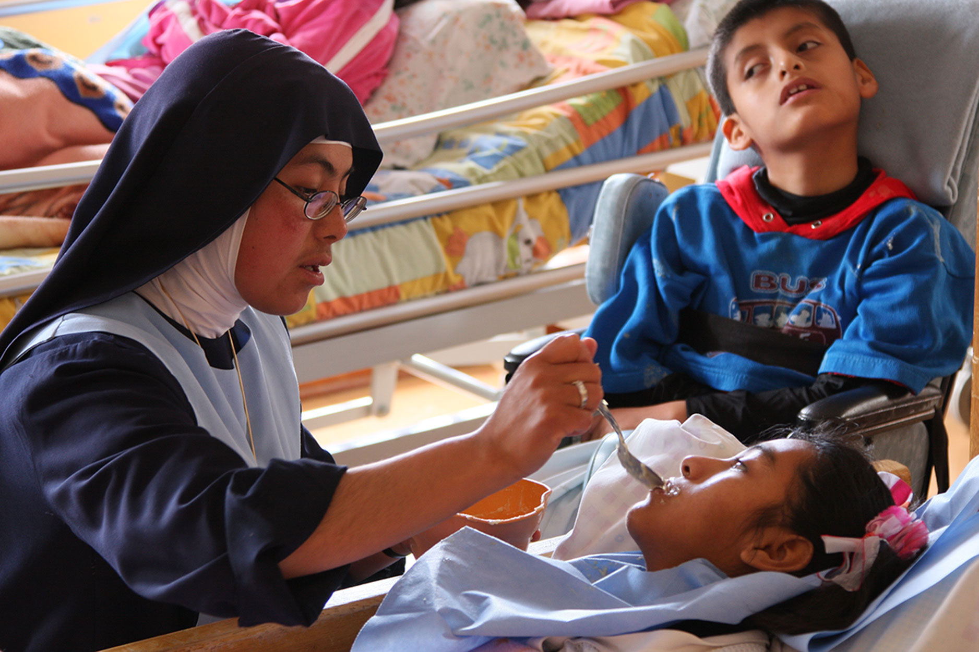
It is in communion,
even when this proves painful,
that a charism is seen to be authentic and mysteriously fruitful.” Evangelii Gaudium

Slide 41
Question:
Where is “the new” -“the fresh” emerging in terms of mission? In the life of COR?

Slide 42
Question:
How are you being
called today as members
of COR to the call…….
to encounter
and to build communion?

Slide 43
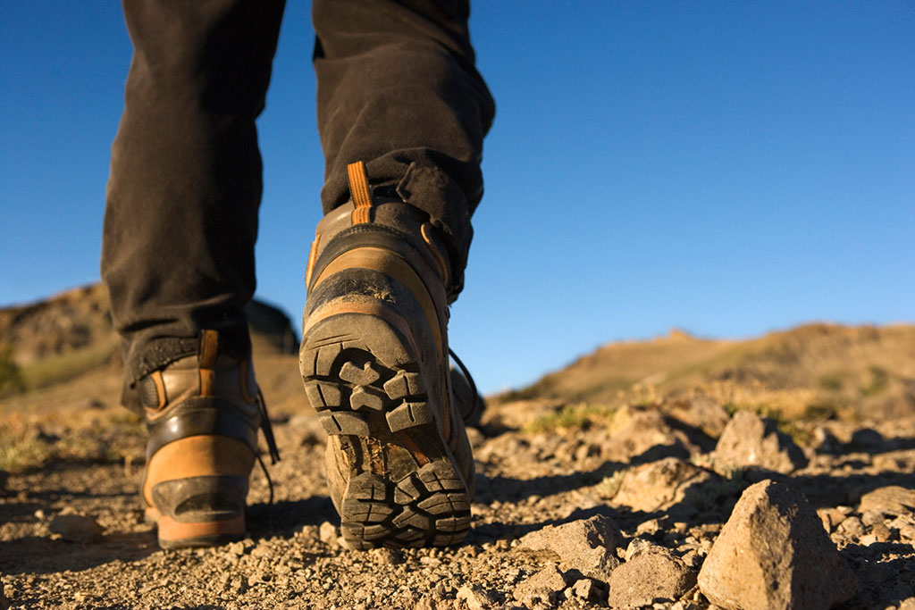
The goal of the journey is towards
unknown lands.
There we will glimpse
“little signs of a new story’
as we travel,
guided by the rhythm
of the Spirit.

