Slide 1
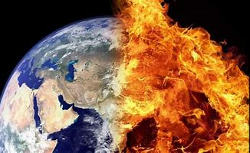
TIME TO COME HOME……
m
MESSAGE OF HOPE AND CHALLENGE IN
A PLANETERY EMERGENCY

Slide 2
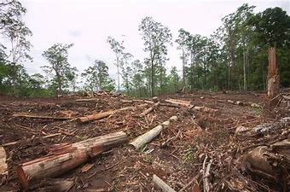
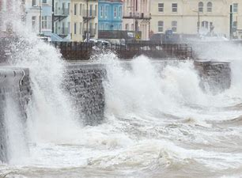
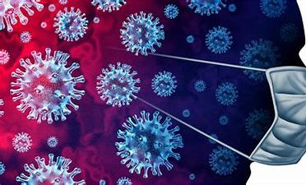
PLANETARY EMERGENCY 2021
Climate Change
Biodiversity Loss
Coronavirus : Covid 19
“Nothing ever goes away until it has taught us what we need to know.”
Pema Chodron

Slide 3
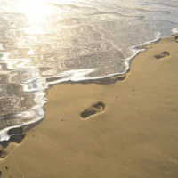
I hear a voice calling
Come deeper now. Come deeper now.

Slide 4
‘I am counting on you to
wake up the world, since the
distinctive sign of consecrated
life is prophesy. This is the
priority that is needed right now.’
(Pope Francis: Letter Year of Consecrated Life 2014).
His exhortation can be summed up thus:
in our present reality look to the past with gratitude,
live the present with passion, embrace the future with hope..
‘That hope we hold. It is like an anchor for our lives, an anchor safe and sure’ (Heb 6:19)

Slide 5
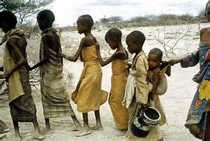
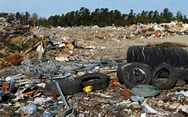
In Laudato Si’ Pope Francis
names the reality as it is in our Common Home – the devastation and destruction – and our implication in this.
He then
appeals to our dignity and responsibility as he calls us to conversion and the constancy of hope.

Slide 6
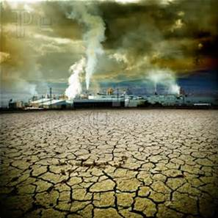
The violence present in our hearts…is also reflected in the
symptoms of sickness evident in the soil, in the water,
in the air and in all forms of life. This is why the earth herself, burdened and laid waste, is among the most abandoned and maltreated of our poor; she groans in travail ‘Rom. 8:22’ (2)
I will attempt to get to the roots
of the present situation,
so as to consider not only its
symptoms but also its
deepest causes (15)
Our economic model “is based on the lie that there is an infinite supply of the earth’s goods, and this leads to the planet being squeezed dry beyond every limit”. LS 106
THE CRY OF THE EARTH, THE CRY OF THE POOR. ( Ls. 49)

Slide 7
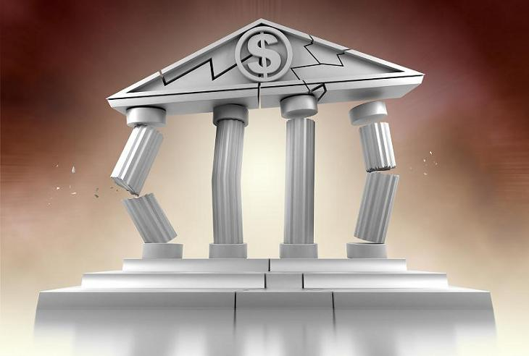
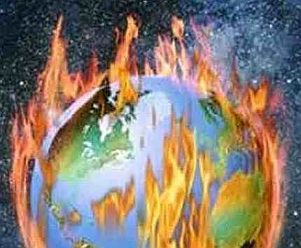
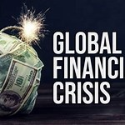
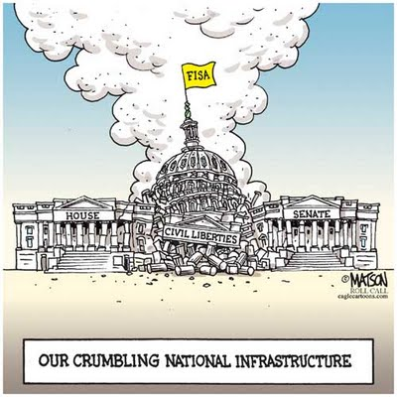
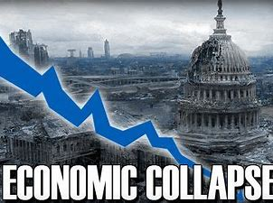
There is little doubt that we have lost our way living out of the old worldview of
separation and dominance……the signs
are all around us…
Notes:
7

Slide 8
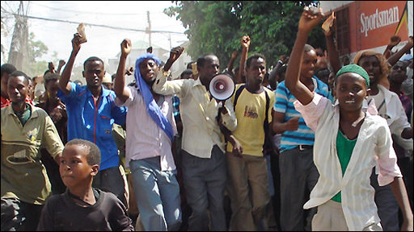
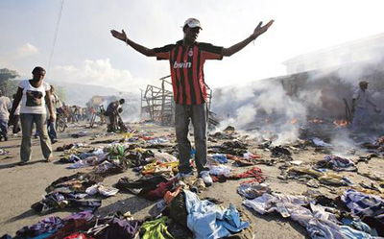
We are in big trouble with the threat of global warming,
coming to the end of an oil-based economy, the present
global economic crisis and massive loss of biodiversity
in the natural world. Biodiversity underpins the processes
that make life possible. The global economic system has
failed us.
We have the crisis of arms and militarism, drugs,
violence in so many forms, refugee crisis, homelessness…..
Notes:
8

Slide 9
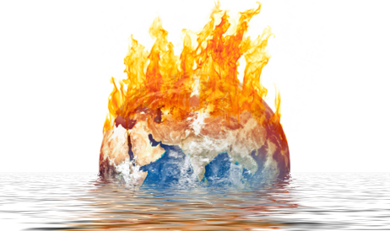
Climate change is the single biggest environmental and humanitarian crisis of our time.
How Do We Know?
Global Temperature Rise
Warming Oceans
Shrinking Ice Sheets
Glacial Retreat
Decreased snow
Sea Level rise
Extreme events
Forest fires
Ocean Acidification
Alarming rise in global refugees and migrants: human and other species.

Slide 10
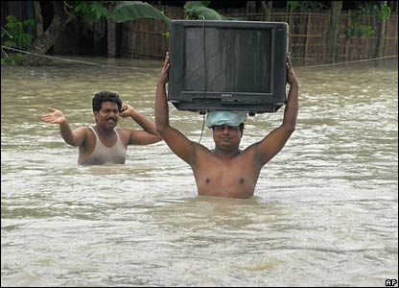
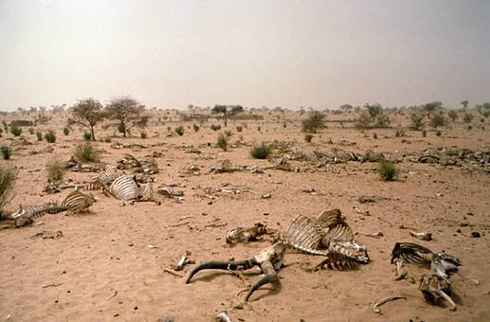
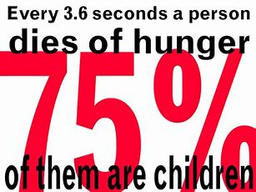
Extreme poverty: mass migrations
Cycle of hunger and lack of clean water
Devastation of living systems of Earth
Rise in weaponry/warfare, global crime…
Notes:
10

Slide 11
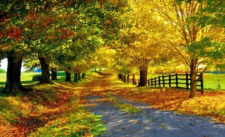
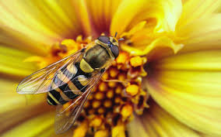
Earth Overshoot Day – 29th July 2021 The date when humanity’s demand for ecological resources and services in a given year exceeds what Earth can regenerate in that year.
We are currently using 1.7 earths
mainly through:
*overfishing
*overharvesting forests
*emitting more carbon dioxide into the
atmosphere than ecosystems can absorb.
The Sun is the source of all life on Earth:
Without plants
No oxygen.
Without bees
No pollination

Slide 12
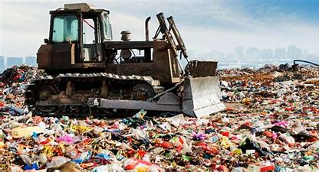
World Resources Institute – Pause for Thought!
Over 1 billion tons of resources flow into the economy
yearly, c.60% ends up as waste or CO2 emissions
PLASTIC WASTE: C.300 MI. TONS IN 2019
ELECTRONIC WASTE: C.50mI. TONS IN ONE YEAR
FOOD WASTE: 1/3 OF ALL FOOD PRODUCED
While millions go hungry
-----------------------
Need to move from current global economic model of
‘create-and-make waste’ to circular economy by avoiding waste, stimulating business growth and creating job opportunities.
Eg. fashion/textile industry = more CO2 than international aviation and shipping combined. It is world’s most polluting industry after oil and accounts for c.8% of global green house gas emissions.

Slide 13
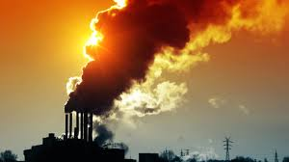
INDUSTRIAL GROWTH SOCIETY WORLDVIEW
Main characteristics:
Over extraction of resources
Consumption as a psychic compulsion
Human well-being as supreme
Jobs at any price
Toxic Waste
Loss of the sense of mystery
God is separate, unchanging
IMAGE: machine

Slide 14
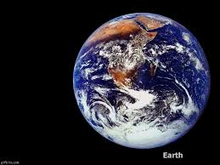
Life Sustaining Society Worldview
Main characteristics:
Sense of the sacred/mystery of the earth
Respect for the carrying capacity of the earth
All part of an interconnected whole
God is present everywhere.
IMAGE: Web

Slide 15
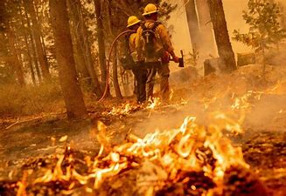
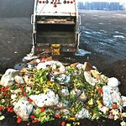
The earth, our home, is beginning to look more and more like an immense pile of filth. LS. 21
What kind of world do we want to leave to those who will come after us, the children who are now growing up? LS 160

Slide 16
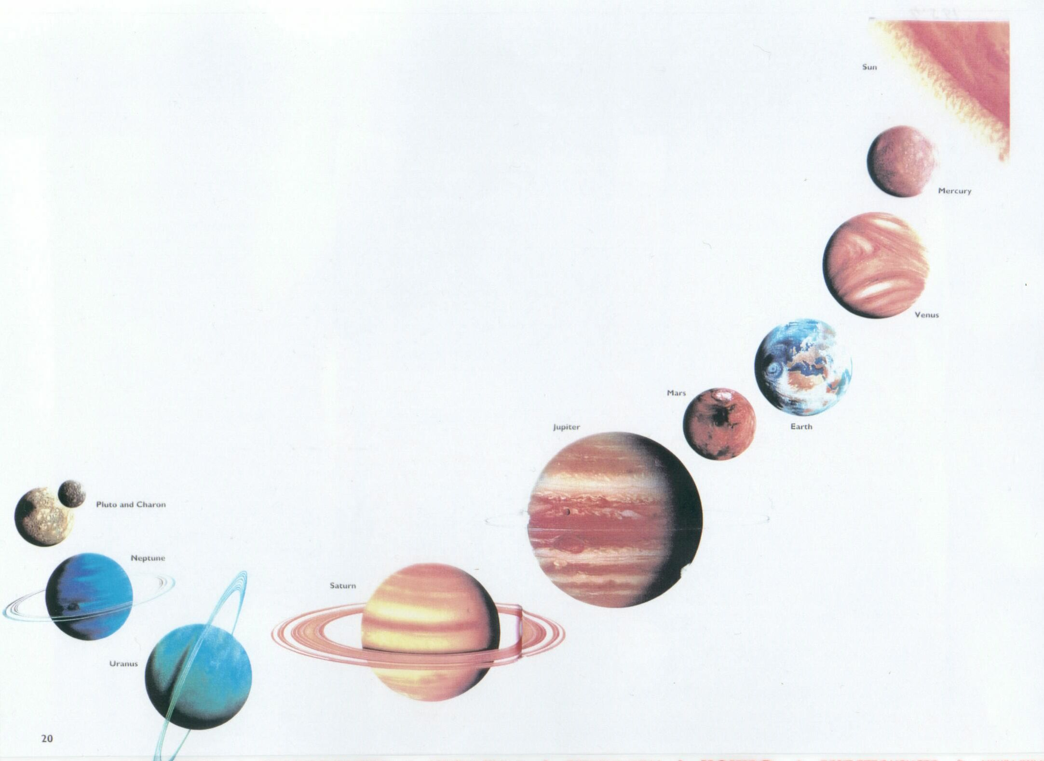
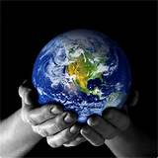
c.4.5 billion years ago
Earth was born
POISE
ELEGANCE
COMPLEXITY
Notes:
16

Slide 17
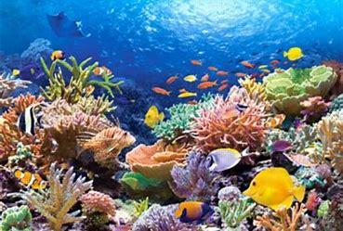
LIFE ON EARTH : 86% ON LAND, 1% IN OCEANS
13% DEEP SUB-SURFACE BACTERIA
HUMANS = 0.01%, PLANTS = 82%, BACTERIA= 13%
EVERYTHING ELSE = 5%
Since the rise of human civilisation:
83% WILD MAMMALS, 80% MARINE MAMMALS,
50% PLANTS, 15% FISH HAVE BEEN LOST.
(Source: escchat.com …. Irish Times 26May 2018)
“Ecosystems and biodiversity are as important to human society
as a heart, liver, kidneys and lungs are to you. Yet its us that’s causing this worldwide biological systems collapse, despite the fact that our own lives- our food, jobs, homes, governance, security and everything else – quite literally depend on their health.”
(Hannah Hamilton ‘Ireland’s Biodiversity needs intensive care’ Irish Times 2019)

Slide 18
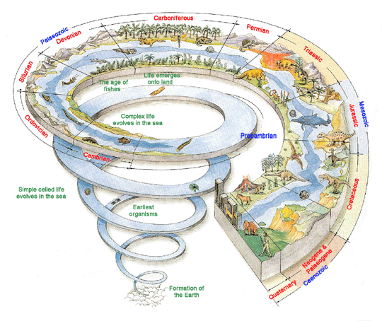
The magnificent complexity of our evolving planet over billions of years
is being rapidly destroyed
and we are seriously implicated in this process. (LS.33).

Slide 19
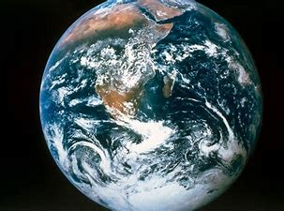
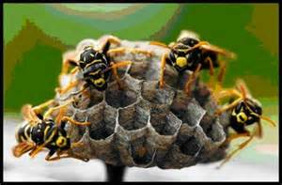
Biodiversity: Sacred Leaven in the Divine Creative Extravagance
Biological Diversity: the variety of life on Earth – all forms,
relationships and interactions – species and entire ecosystems.
Life in oceans, on land, in the skies and sub-surface bacteria.
‘Without biodiversity, there is no future for humanity’.
Prof. David Macdonald (Oxford University)
‘If we lose the insects then everything is going to collapse.’
Prof. Dave Gaulson, Sussex University, UK
‘This being the only living world we are ever likely to know, let us
join to make the most of it.’ Prof. E.O. Wilson in 1985
Throughout the current Covid pandemic both UN and WHO
have been warning that the world must tackle the cause of such outbreaks- the destruction of nature- and not just the health and economic symptoms. ( The Guardian, 05 Aug 2020)

Slide 20
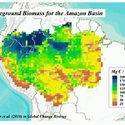
The Amazon Basin stretches
across 9 countries and more than
2 million sq. acres.
Home to planet’s greatest biodiversity’.
33 million people, 400 different tribes
c. of which 100 live in voluntary isolation.
This biome produces c. 20% of world’s fresh water,
c.25% of its oxygen and one – third of global forest reserves.
“The equilibrium of our planet also depends on the health of the Amazon Region”.
‘Querida Amazonia’ Pope Francis 2020
It is also an epicentre in the battle between
preservation and development

Slide 21
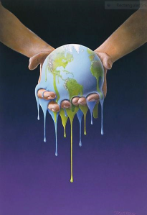
Our own destiny as individuals or as a human species and the destiny of the Earth are identical.
What we do to the Earth, we do to ourselves.
Our wellbeing and health are inextricably linked to the ecological health of the planet.
Thomas Berry
“Only when the last tree has died and the last river has been poisoned and the last fish has been caught will we realise that we cannot eat money.”
19th Century Cree Indian

Slide 22
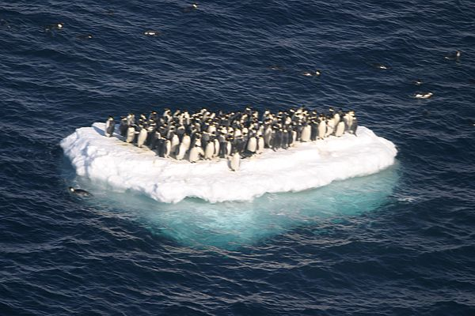
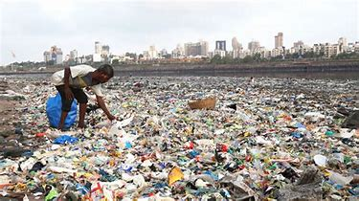
A POEM by Drew Dillinger
It’s 3.23 in the morning and I’m awake because my great, great, grandchildren won’t let me sleep. My great, great, grandchildren ask me in dreams what did you do while the planet was plundered? What did you do when the earth was unravelling?
Surely you did something when the seasons started failing as the mammals, reptiles and birds were all dying?
Did you fill the streets with protest when democracy was stolen? What did you do once you knew?
WHAT DID YOU DO ONCE YOU KNEW?

Slide 23
‘If you do not change direction, you may end up where
you are headed’ Buddha
‘The best way to predict your future is to create it.’ Abraham Lincoln
‘ You cannot solve today’s problems with the mindset that
created them. Albert Einstein
‘Never doubt that a small group can change the world,
it is the only thing that ever has.’ Margaret Meade
I have come that you may have life, life in abundance Jn 10:10
‘ Be the change you wish to see in the world’ Gandhi
‘What we do with our heart affects the whole universe’.
Carmel of Reno

Slide 24
It’s all a question of story:
primary hope for the future.
We are in trouble just now because we do not have a good story.
We are in between stories.
The old story, the account of how the world came to be and how we fit into it, is no longer effective.
Yet we have not learned the new story.
The Dream of the Earth, Thomas Berry

Slide 25
Our Common Home
The Universe was born
from a tiny pinhead of energy
bursting and expanding into a
massive fireball.
This tiniest pinprick of energy
contained all the light and potential for everything that would ever come to be.
How mysterious: everything that has been, is, or ever will be, was contained within the miracle of hydrogen almost 14 billion years ago!

Slide 26
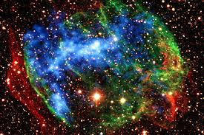
ESSENCE OF THE NEW STORY OF THE UNIVERSE
We live in an evolving and expanding universe where
everything is forever in the process of BECOMING….
nothing is entirely fixed, unchanging, predictable…
Sharing with all beings the same atoms, minerals, chemicals as the stars – we are stardust - and have evolved in deep time over c.14billon years carrying the wisdom of the evolving universe in every fibre of our being.

Slide 27
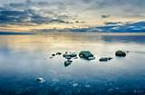
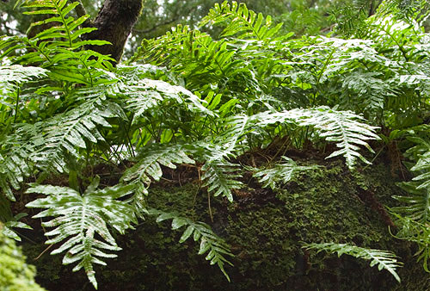
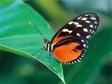
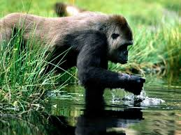
Humans share 30% DNA with plants,
60% DNA with insects and 98.4 % with
chimpanzees.
The salt in our blood and tears is from the ancient seas.
Each being is unique, different but not separate in
the web of life.

Slide 28
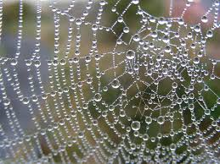
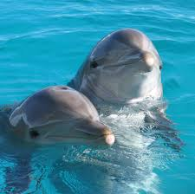
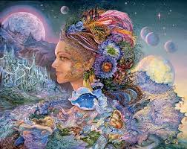
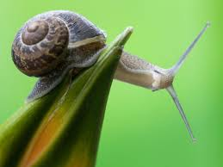
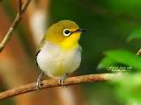
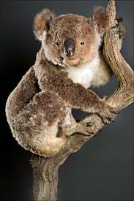
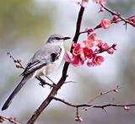
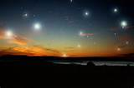
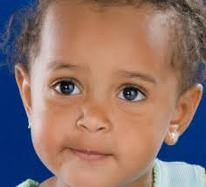
IN THE MAGNIFICENCE
OF GOD’S CREATIVE ENERGY
EACH ONE IS REFLECTED IN
AND
REFLECTS EVERY OTHER
IN THE AMAZING WEB OF LIFE

Slide 29
“The conversion we seek….
entails a loving awareness that we are not separate from the rest of creatures, but joined in a splendid universal communion.”
LS 220.
Woven into our lives is the very fire from the stars and the genes from the sea creatures, and everyone, literally everyone, is kin in the radiant tapestry of being. This relationship is not external or extrinsic to our identity but wells up as the defining truth from our deepest being.
(Elisabeth Johnson)

Slide 30
Current exploration into the complex and mysterious nature of our Universe reveals how little is actually visible/known to us. Visible reality - all ordinary matter -is merely 5% of the whole while 5% is dark matter and 90% dark energy.

Slide 31
We, all beings, are a
microcosm of this reality…..
Each of us is an
inexhaustible mystery
with
inexhaustible richness
within:
we will never know it
totally.
A.H. Almaas
There is a lonely edge to our lives which can only be filled by God. Meister Eckhart

Slide 32
WHO AM I? WHO ARE WE?
‘We are God’s work of art’
(Eph. 2:10)
Before I formed you in the womb, I knew you..
(Jer.1:5)
‘I have called you by name, you are mine…
….Because you are precious in my
my eyes and honoured, and I love
you.. (Is. 43)

Slide 33
We are part of God’s
continuing new creation,
one substance with the
rest of creation…….
All of life, our life and every
life, is a gift.
That’s what love is about.
God’s love at the heart of
the cosmos is a love that
heals, makes whole and
generates new life.
Ilia Delio “To Explore a New Paradigm for Christian Living”.
“Love is a sacred reserve of energy; it is like the blood of spiritual evolution.”
Teilhard de Chardin

Slide 34
I am the fiery essence of God:
I flame above the beauty of the fields;
I shine in the water;
I burn in the sun, the moon and the stars
And with the airy wind I quicken all things vitally by
an un-seen all-sustaining life….
Hildegard of Bingin

Slide 35
A sincere seeker said:
‘I have always longed to see God
everywhere and in all things,
and live in God’s presence.
I have practiced it but I
haven’t succeeded.’
‘This isn’t something you bring about by
practice, the sage replied. ‘When you
understand who you are, you’ll
no longer seek God’s presence, you’ll
realise that you are God’s presence’
(The Ocean in the Dewdrop by Francis J. Padinjarekara)
…nature as a whole not only manifests God but is also a locus
of God’s presence. LS 88

Slide 36
Our Deepest Fear
‘Our deepest fear is not that we are inadequate.
Our deepest fear is that we are powerful beyond measure.
It is our light, not our darkness that most frightens us.
We ask ourselves: Who am I to be brilliant, gorgeous, talented and fabulous?
Actually, who am I not to be?
You are a child of God.
Your playing small does not serve the world……….
Marianne Williamson
“Always be prepared to give expression to the hope that is in you.”
1Pet. 3:15

Slide 37
COMING HOME TO WHO WE REALLY ARE IN THE
COMMUNITY OF CREATION: OUR COMMON HOME
*owning our primary identity: good, blessed, holy
*trusting our inner wisdom, divine energy
*embracing inner healing with compassion
*knowing that we can make a difference
*that we are not alone
*earth has much to teach us
*oneness in diversity is our strength
All is gift, all is holy, all is in communion
Behold, I am with you always, to the end of time. (Mt 28:20)

Slide 38
We have outgrown the small story of our lives and the small selves to which so many have confined themselves. It is time to move through life motivated... by gratitude and an abiding zest for living out of our higher purpose. Jean Houston
“Let yourself be silently drawn by the stronger pull of what
you really love.” Rumi

Slide 39
Everything in the Universe is within you. Ask all from yourself.
Rumi
Going inward and making room in oneself for the immensity of the universe…
will transform us…providing the physic energy needed to creatively imagine
an alternative future.

Slide 40
Nothing here below is profane for those who know how to see.
On the contrary, everything is sacred. Teilhard De Chardin
We are ALL enclosed in God and God is enclosed in ALL of us. Julian of Norwich
If there is no spirituality in the Earth, then there is no spirituality
in ourselves. Thomas Berry
The universe unfolds in God…Hence there is a mystical meaning
to be found in a leaf, in a mountain trail, in a dewdrop, in a poor person’s face…. LS.233

Slide 41
“The world is filled with the grandeur of God”
G.M.Hopkins
We are not human beings
on a spiritual journey.
We are spiritual beings
on a human journey…..T.de Chardin
All beings created by God are
spiritual beings on their unique journey….stars,planets, fish, plants, insects, animals, birds…..
The fullness of joy is to behold God in all things. Julian of Norwich

Slide 42
As we recover the theology of
Creation as context –including
redemption – it challenges us to
focus on essence as soul with
respect for all life in the mystery of
divine creativity.
‘The day of my spiritual awakening
was the day I saw and knew that I saw God in all things and all things in God’
Mechtilde of Madgeburg

Slide 43
REFLECTION
WE ARE SPIRITUAL BEINGS ON A HUMAN JOURNEY
RATHER THAN
HUMAN BEINGS ON A SPIRITUAL JOURNEY.
Attributed to Teilhard de Chardin

Slide 44
opportunityisnowhere
Developing Ecological Consciousness by Christopher Uhl

Slide 45
PASSIVE HOPE: waiting for external agencies to bring about what we desire
ACTIVE HOPE: becoming active participants in bringing about what we hope for.
Active Hope is something we do, rather than have. It is a process with 3 stages:
Take a clear view of reality
Identify desired direction and values
Take steps to move ourselves/our situation in that direction.
Q.s When I look at our reality – what concerns me? Feelings?
How might I see with new eyes? Where to focus my energy?
My hope for the future is..? Joanna Macy & Chris Johnstone

Slide 46
THE TRUMPET IS SOUNDING RIGHT NOW FOR HUMANITY
We cannot continue to fight,
pollute, over-populate, and destroy our
environment because we remain
trapped in the illusion of separation.
We will either evolve towards a higher order of love and
creativity, or we will self-destruct.
Barbara Marx Hubbard
A frog does not drink up the pond in which it lives.
American Indian Proverb

Slide 47
The change required is from a self-image dominated by a
perception of ourselves as having the right to use earth’s
resources independently of the needs of all other beings.
This in turn requires theological change: from an image of God
as granting us the power to do this.
Part of a theological response to this state of affairs must be
a willingness to change our images
of God from those that sanction
V violence towards others and
degradation of the earth’s resources,
to those that encourage us to relate
non-violently to each other, to the
earth and to God.
Anne Primavesi: Gaia and Climate Change

Slide 48
AN INTEGRAL ECOLOGY
Social
Political
Cultural
Environmental
Economic
Spiritual/Religious
….we have to realise that a true ecological approach always becomes a social approach…..so as to hear both the cry of the earth and the cry of the poor. (LS 49). Strategies for a solution demand an integrated approach…. (LS 139)
We urgently need a humanism capable of bringing together the different fields of knowledge, including economics, in service of a more integral and integrating vision (LS.141).

Slide 49
Sustainable Development Goals 2016 - 2030
Notes:
49

Slide 50
If God is at the heart of this physical, evolving cosmos, then love is the energy that makes everything precious. God is the ultimate wholeness and depth of love, the inner Omega of everything from the smallest quark to the largest galaxy. Because divine love is totally other-centered, the whole cosmos is a theophany, a revelation of God’s glory.
Ilio Delio
Whatever our project, or wherever we focus our energy, unless we are situating it within the context of the total community of life on the planet, we are failing to be faithful interpreters of the Signs of the Times. Thomas Berry

Slide 51
The universe expresses itself in the blazing
radiance of the stars and in the vast reaches
of the galactic systems
but
its most intimate expression of itself
is in this tiny planet.
In turn, this unique planet could not exist in its
present form except in a universe such as that in
which it has emerged and from which it has
received its life energies.
Thomas Berry

Slide 52
The universe as a whole, in all its manifold relationships, shows forth the inexhaustible richness of God. (LS 86)
Rather than a problem to be solved, the world is a
joyful mystery to be contemplated
with gladness and joy . (LS.12)

Slide 53
Perhaps a new revelatory experience is taking place,
an experience wherein human consciousness awakens to the grandeur and sacred quality of the Earth process. Humanity has seldom participated in such a vision since shamanic times, but in such a renewal lies our hope for the future for ourselves and for the entire planet on which we live.
We are not lacking in the dynamic forces needed to create the future…we live in a sea of energy beyond all comprehension.
Thomas Berry: The Great Work

Slide 54
We live in a planet of abundance not scarcity where there is enough for the needs of all but not for the greed of the few. When less than 20% - people and corporations – own or control over 80% of global resources and create over 80% of waste it results in continuing alarming injustices, inequalities, poverty, starvation, homelessness, migrations, war…
Each community can take from the bounty of the
earth whatever it needs for subsistence, but it also has the duty to protect the earth and to ensure its
fruitfulness for coming generations. (LS 67)

Slide 55
Imagine how literally everything in our lives would be changed if we could learn from Nature and work together instead of dominating/manipulating the natural processes, eg, food production, energy, manufacturing materials, healing ourselves, storing information, conducting business, doing governance….?

Slide 56
We did not come into the world but came out of it.
What do I stand for? Do I stand for what I stand in?
OUR COMMON HOME WITHIN THE EVOLVING UNIVERSE?

Slide 57
To come home is undoubtedly the great work of our time, the challenge is to join the earth as a participating member. This truth is slowly dawning on us as we struggle with current planetary emergencies . This is a process of un-learning false assumptions and beliefs – that we are somehow not of earth- and learning our true identity as a species among species in the wondrous web of life in our Common Home.

Slide 58
We imagine the Divine as distant and inaccessible,
whereas, in fact we live steeped in its burning layers.
Teilhard De Chardin
.
We did not come into the world, we came out of it.
Make your home in me as I make mine in you. Abide in my love.
Jn 15:4ff

Slide 59
Our Human destiny is integral with the destiny of the Earth
The time has come to:
to lower our voices
to cease imposing our mechanistic patterns on the
biological processes of earth
to resist the impulse to control, to command,
to force, to oppress
AND
to begin quite humbly to follow the guidance of the
larger community on which all life depends.
The Dream of the Earth: Thomas Berry

Slide 60
The environment
is the reason
we are ALIVE.
It is the reason
God is ALIVE
for us.
Take away the
environment
and you take away
God.
It is physically impossible
for us to
encounter God elsewhere.
Anne Primavesi : Faith in Creation 1995
“Earth’s crammed with heaven and every common bush aflame with God…”
Elizabeth Browning

Slide 61
If we could see ourselves
as Earth rather than Earth
as existing for us –
our perspective is transformed.
I cannot be by myself
I can only interbe with everything else.
Anne Primavesi : Sacred Systems

Slide 62
As Thomas Berry describes it: “ We are not left simply to our own rational contrivances. We are supported by the ultimate powers of the Universe as they make themselves present to us through the spontaneities within our own being”.
Our Common Home is a limitless sea of energy filled with a
passion for the possible – let it ignite us for the greater good!

Slide 63
HOMO-UNIVERSALIS
“
We are on the cusp of an evolutionary leap….
the evolutionary leap occurs precisely at the time when our intelligent species has reached an existential crisis to life on earth that cannot be resolved by doing more of the same…
we are facing extinction or conscious evolution.”
HOMO SAPIENS ---HOMO UNIVERSALIS
The invitation is to get in touch with our essence, that sacred impulse which knows our universe-self coded within, yearning to become the more……the source of love that created the whole universe is in me…..we are all co-creators, members of an awakening species in an evolving universe.
Barbara Marx Hubbard

Slide 64
We need to urgently find creative ways of living more sustainably so that all beings may feel at home in our common home. The time has come for us to live as participants with earth mindful of her bountifulness and respecting finite resources.
Notes:
64

Slide 65
We are in an unprecedented emergency!
We must act quickly- our Common Home-
is in peril and science is telling us that we
have less than a decade to halt potentially
irreversible damage to Earth’s living systems on which all life depends.
CAN WE TOGETHER TURN THE TIDE:
FROM EMERGENCY TO EMERGENCE?
FROM SOLUTIONS TO SOUL-UTIONS?

Slide 66
IF WE UNDERSTAND OUR DEEP CONNECTION AND
RELATIONSHIP WITH THE EARTH, WE WILL HAVE ENOUGH
LOVE, STRENGTH, AND AWAKENING
TO LOOK AFTER OURSELVES AND THE EARTH
SO THAT WE BOTH CAN THRIVE. Thich Nhat Hanh
Real change will only happen when we fall in love with our planet .
Only love can show us how to live in harmony with nature and with each other and save us from the devastating effects of environmental destruction and climate change. Love Letter to the Earth

Slide 67
We are the first
generation to know
the story of our evolving
and expanding universe.
We are the last generation
able to change
the future.
Divine Gate-Keeper….your wisdom will direct my inner footsteps
As I face the future’s unmarked terrain.
Your rapt attentiveness assures me
That you will guide my comings and goings.
This day I join my heart with all living beings
As we walk together toward what lies ahead.
(Fragments of your Ancient Name , Joyce Rupp)

Slide 68
CODE RED FOR HUMANITY (CRH)
CONTEXT: The entire life community must progress-from homo-centric
to a bio-centric norm of progress in their bioregional identity
RESILIENCE: We re-inhabit the earth community as a participating
member
HOME – EARTH: We come home to foster and progress the innate
potential of the local communities to which we
belong in their bioregional endowment and
fruitfulness.

Slide 69
We all lose when it’s about my money.
We all win when it’s about
our wellbeing.
The most precious gift of our human experience
is the opportunity to feel the joyful exhilaration
that comes from fulfilling our responsibility to share
in the care of life.
We must organize around what makes
communities most healthy rather than what makes
corporations most profitable.
Our future depends on a dramatic transformation in our understanding of ourselves, and our relationships with one another and Earth
David Korten: Ecological Civilization

Slide 70
OUR HOPE IS IN TRUSTING THE WISDOM OF EARTH GARNERED OVER 4.5 BILLION
YEARS OF LIVED EXPERIENCE : EARTH KNOWS – WILL WE LISTEN?
Earth is a living
organism
within the mystery
of the
evolving and
expanding
Universe.
The human can be identified as that being in whom the earth reflects on and celebrates itself in self-conscious awareness
Our planet Home
has survived
ice-ages, floods,
droughts, fires and
storms throughout
its arctic and tropical, coastal and inland regions, its mountains and plains, river valleys
and deserts over the ages.

Slide 71
The following components of Earth give us
an insight into the wisdom and resilience of
our common home:
Earth: Self-propagating: every instant a million new
faces emerge.
This challenges us re. earth’s resources to ensure safe habitat, food, shelter,
protection and care of young of all beings and their right
in realising their full potential.

Slide 72
Earth: Self-nourishing: the interaction of Sun and Earth is key. Photosynthesis.
Seeds, pollination, fertile soil, teeming oceans and control of population to
keep the planet in healthy balance.
The challenge for us is to work in partnership with Earth in ensuring continual
self-nourishing eg.
Challenging large corporations re. destructive practices in agriculture, fishing etc
Preserving and nurturing the soil – free of harmful chemicals and toxins, fallow time
and crop rotation
Keeping our oceans, rivers vibrant, free from harmful leakages eg slurry, oil, waste and reducing plastics
Creating/Managing biodiversity – pollination, food production…
Managing population to ensure vital resources for all in community of life.

Slide 73
Self-healing: within earth are not only nourishing energies
but also powers of re-generation eg. drought or forest damage.
We can assist this healing process by ceasing the flow of poisons and
stopping the creation of toxins
Self-educating: through physical, chemical, biological and cultural patterning.
The entire evolutionary process is a most remarkable feat of self-education, the billions of
experiments in designing the existing life system. This forms a model for humans – which we
need so urgently at present eg the self-destruct properties of runaway climate change,
the folly of militarism and weapons of mass destruction, soil depletion etc
Self-governing: In a forest every component is involved with governance, in oceans also and
in the skies. Governance is provided by the changing seasons, climate and weather patterns,
the salinity of the oceans etc.

Slide 74
Self-fulfilling: Earth is fulfilled in each of its components-
natures delights – birdsong, twinkling of stars, music of waters, flowering of plants, the song of insects, birds in flight…seasonal modes eg. spring and new life, summer and bloom, autumn and abundance, winter and fallow-renewal.
Humans participate in this self-fulfilling as earth reflecting on itself in self-conscious awareness- ritual, music, dance, poetry, drama, literature, architecture, sculpture etc….
There is really only one system, the interacting universe, the earth system conforms to this larger universe system in all its functioning.
We humans are challenged to align our various systems, which are sub-systems of earth, to do likewise ie. economics, politics, health, education, religion…
We must find our way home without delay
This is where we belong and flourish!
Components of Earth – courtesy of Thomas Berry

Slide 75
Establish relationships and connections to safeguard the living systems
of our planet: air, water, sun,
soil…
PROMOTE /PRESERVE
BIODIVERSITY
REDUCE CO2 EMISSIONS
ELIMINATE TOXINS
COMMUNE WITH /LEARN FROM NATURE
GROW IN AWARENESS and COMMITMENT
SUPPORT LOCAL/GLOBAL EFFORTS
SUBTLE ACTIVISM
LET US ACT NOW!!
All it takes is
one good person
to
restore hope.
Ls.71

Slide 76
SUBTLE ACTIVISM :
We live from an evolving consciousness,
knowing that everything we
imagine,
think,
say, pray for,
feel and do
impacts all of life.

Slide 77
FURTHER SIGNS OF HOPE………
Pandemic ‘breathing space’ to re-imagine a more sustainable future
Message of Laudato Si’ (2015)- Our Common Home
Season of Creation Celebration – Yearly
Eco-congregational Initiatives – ecumenical
Youth Climate Fridays: Global Action
Proposed Global Green Deals to cut emissions by -2030
Earthshot 10 year Initiative – Prince William 2021
Global Tree-planting programme
Young Global Leaders Forum & National Geog. Society – Campaign
for Nature = protecting 30% of planet by 2030
The Great Green Wall – Africa -8.000 km from E toW south of Sahara
Organic Food production, local, national, global – Farmers’ Markets
Transfer of Assets from Fossil Fuels globally eg 350.org – Bill Mc Kibben
Prophetic voices: eg Sir David Attenborough, Jane Goodall, Greta Thunberg, Brian Cox..
Investigative Journalism: The Guardian, Common Dreams, Channel 4 etc.

Slide 78
What lies before us and what lies
behind us are small matters
compared to what lies within us.
AND
when we bring what is within
out into the world,
miracles happen.
H.D. Thoreau

Slide 79
Every day I see or hear something that more or less kills me with delight,
That leaves me like a needle in a haystack of light.
It is what I was born for
To look, to listen, to lose myself inside this soft world,
To instruct myself over and over in joy and acclamation...
Mindful by Mary Oliver - Mary Oliver

Slide 80
The Universe is holding its breath
waiting for you
to take your appropriate
place……..no other part of creation can substitute for you belonging to the world.
WAITING FOR YOU
To come out of the shadows
into the light…we are the
light.. become radiant beacons!
Jean Houston

Slide 81
“ I am the light of the world, anyone who follows me will have the light of life.”
Jn.8:12
“If light is in your heart, you will always find your way home.”
Rumi

Slide 82
What is my heart’s desire at this time of uncertainty in our Common Home?
Name one commitment/action that we as Congregation might take in response to the cry of the earth, the cry of the poor today?

Slide 83
Copyright Nellie Mc Laughlin 2021
With thanks to colleagues and Google Images
Copyright Nellie Mc Laughlin 2016
With thanks to Colleagues and Google Images

